Slide 1

K-Nearest Neighbors
Presented by:
Elizer Ponio Jr.
Department of Computer Science
College of Computing and Information Technologies

Slide 2
Outline
Why do we need KNN?
What is KNN?
How do we choose the factor “K”?
When do we use KNN?
How does the KNN Algorithm work?
Use Case: Predict Diabetes
Notes:
Have you asked yourself the question, why do people organize?
Lets go to the psychology of organizing
This predictability applies within the context of our homes, manifesting through the concept of organization

Slide 3
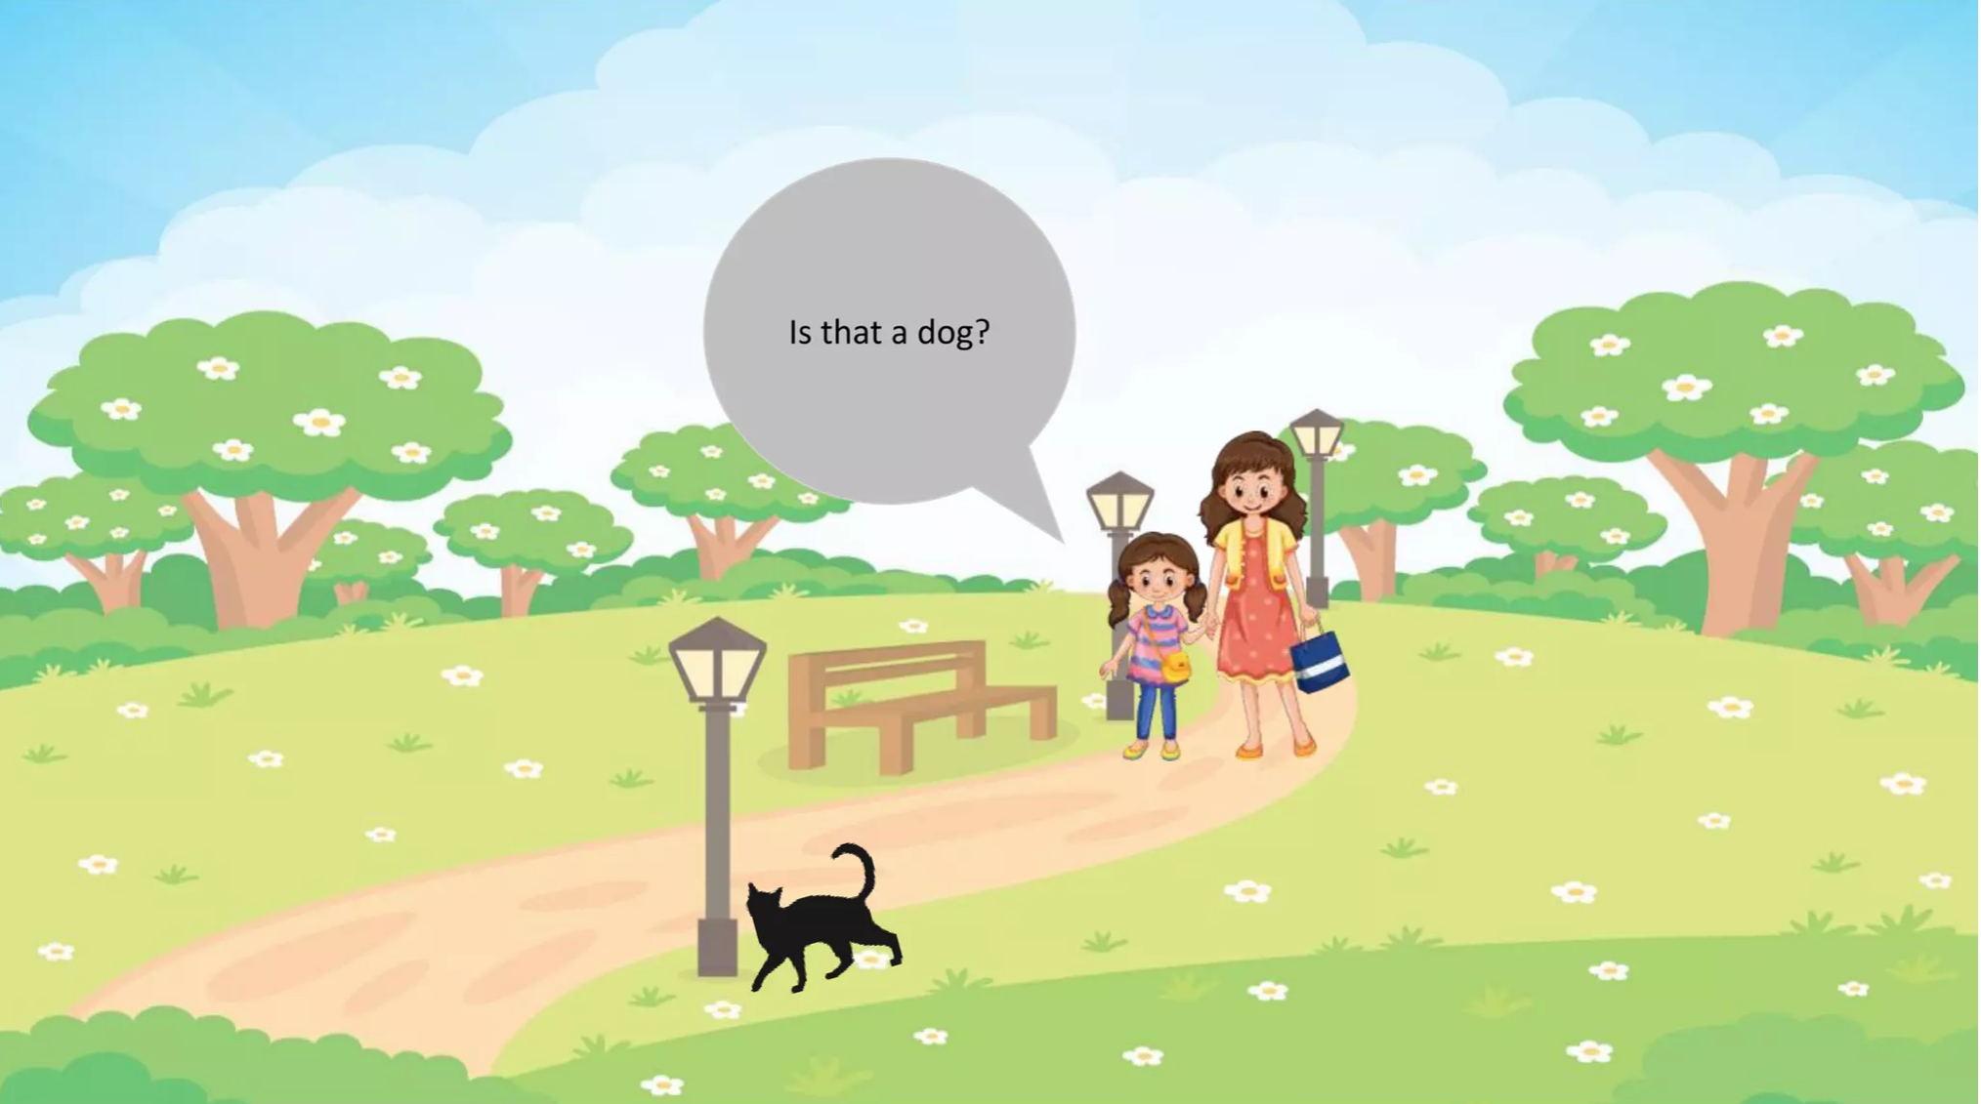
Notes:
Have you asked yourself the question, why do people organize?
Lets go to the psychology of organizing
This predictability applies within the context of our homes, manifesting through the concept of organization

Slide 4
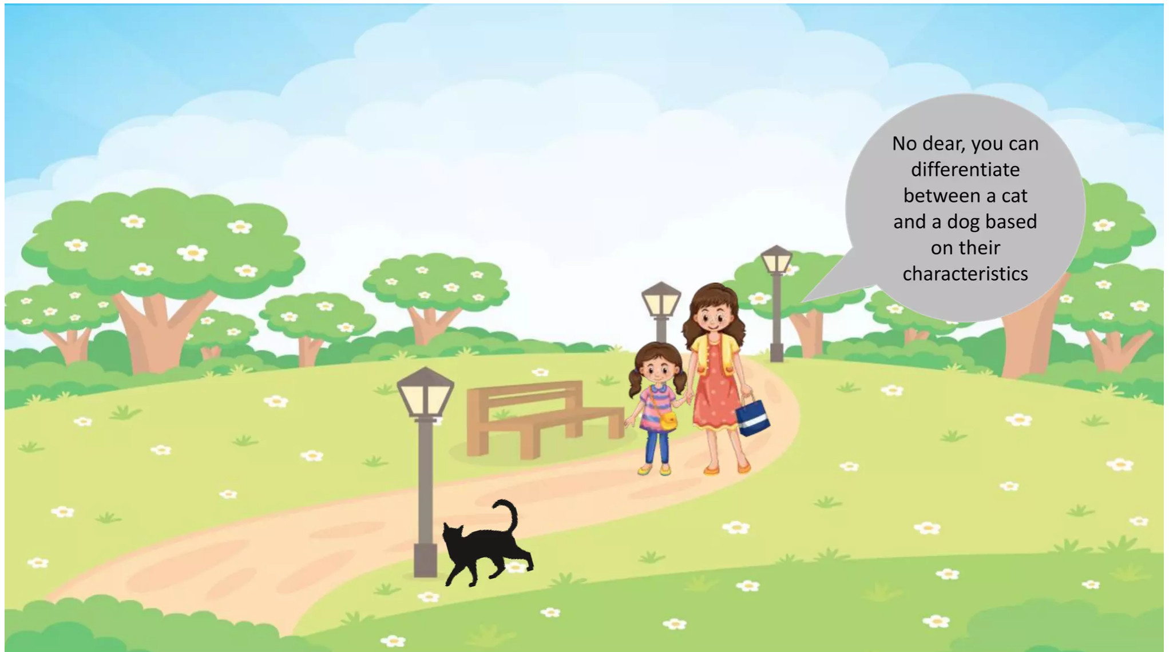
Notes:
Have you asked yourself the question, why do people organize?
Lets go to the psychology of organizing
This predictability applies within the context of our homes, manifesting through the concept of organization

Slide 5
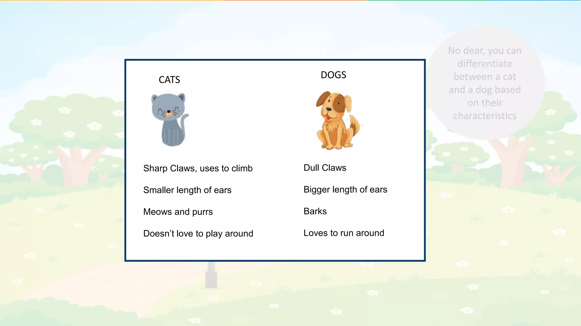
Notes:
Have you asked yourself the question, why do people organize?
Lets go to the psychology of organizing
This predictability applies within the context of our homes, manifesting through the concept of organization

Slide 6
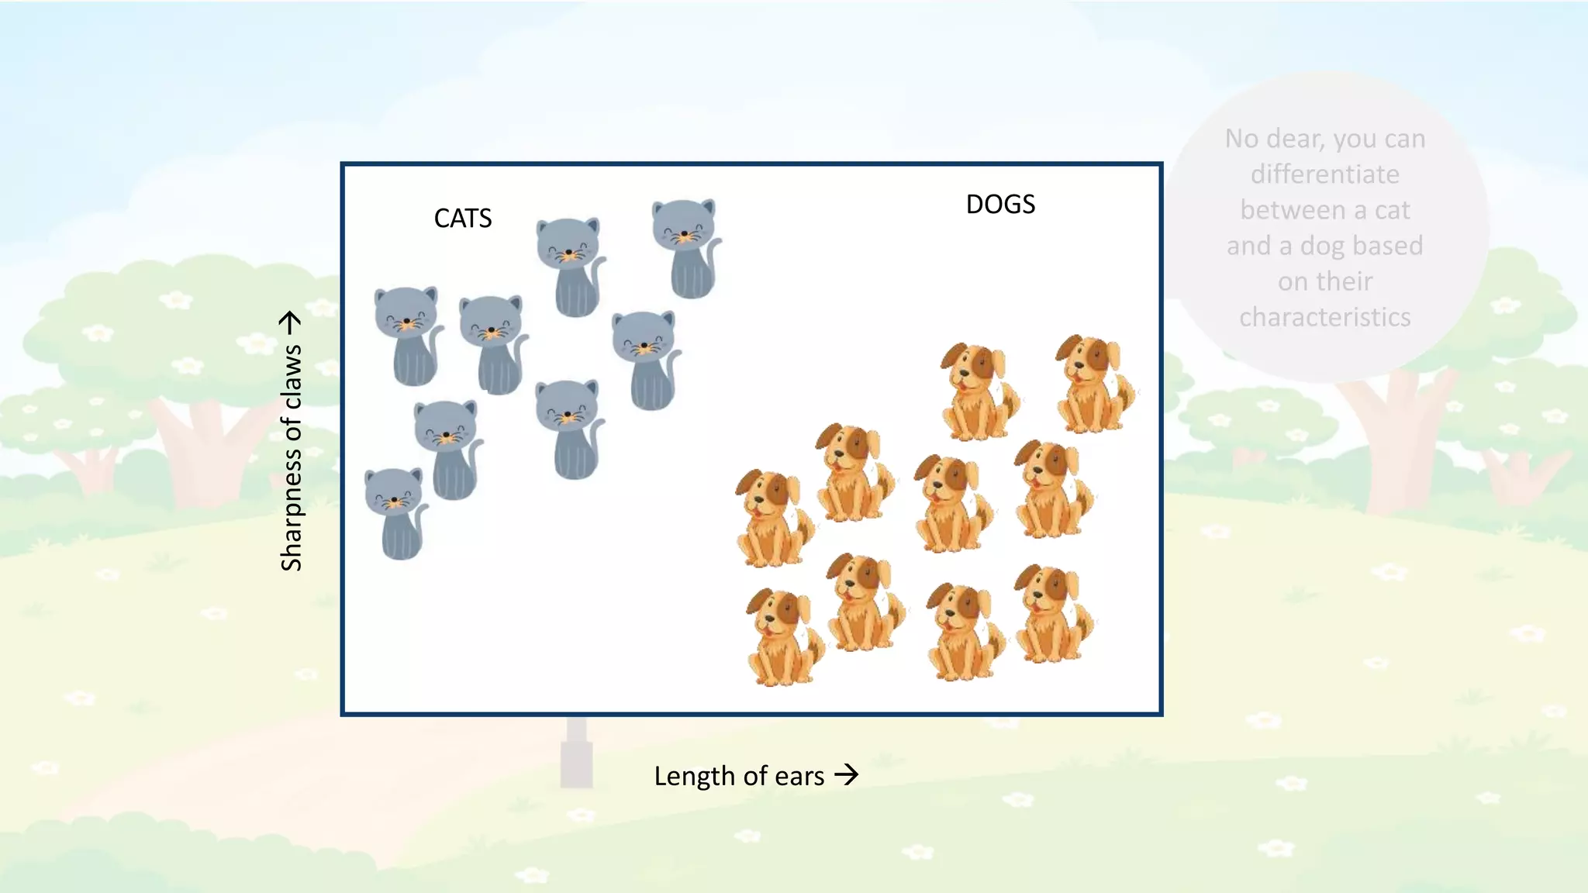
Notes:
Have you asked yourself the question, why do people organize?
Lets go to the psychology of organizing
This predictability applies within the context of our homes, manifesting through the concept of organization

Slide 7
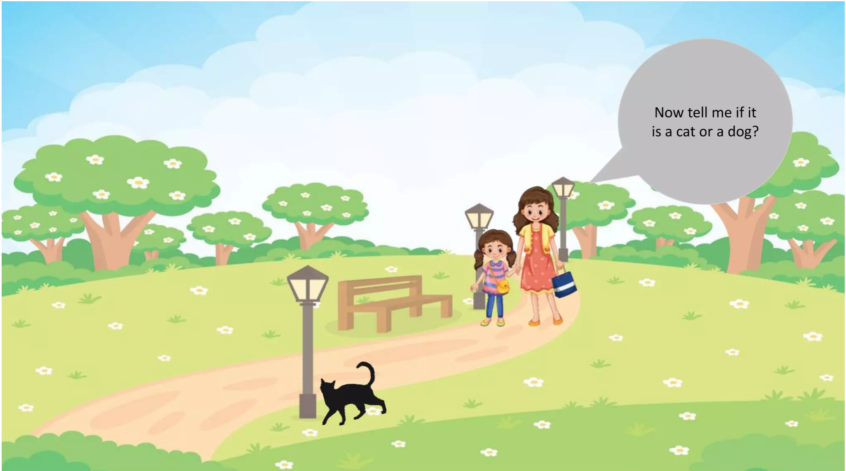
Notes:
Have you asked yourself the question, why do people organize?
Lets go to the psychology of organizing
This predictability applies within the context of our homes, manifesting through the concept of organization

Slide 8
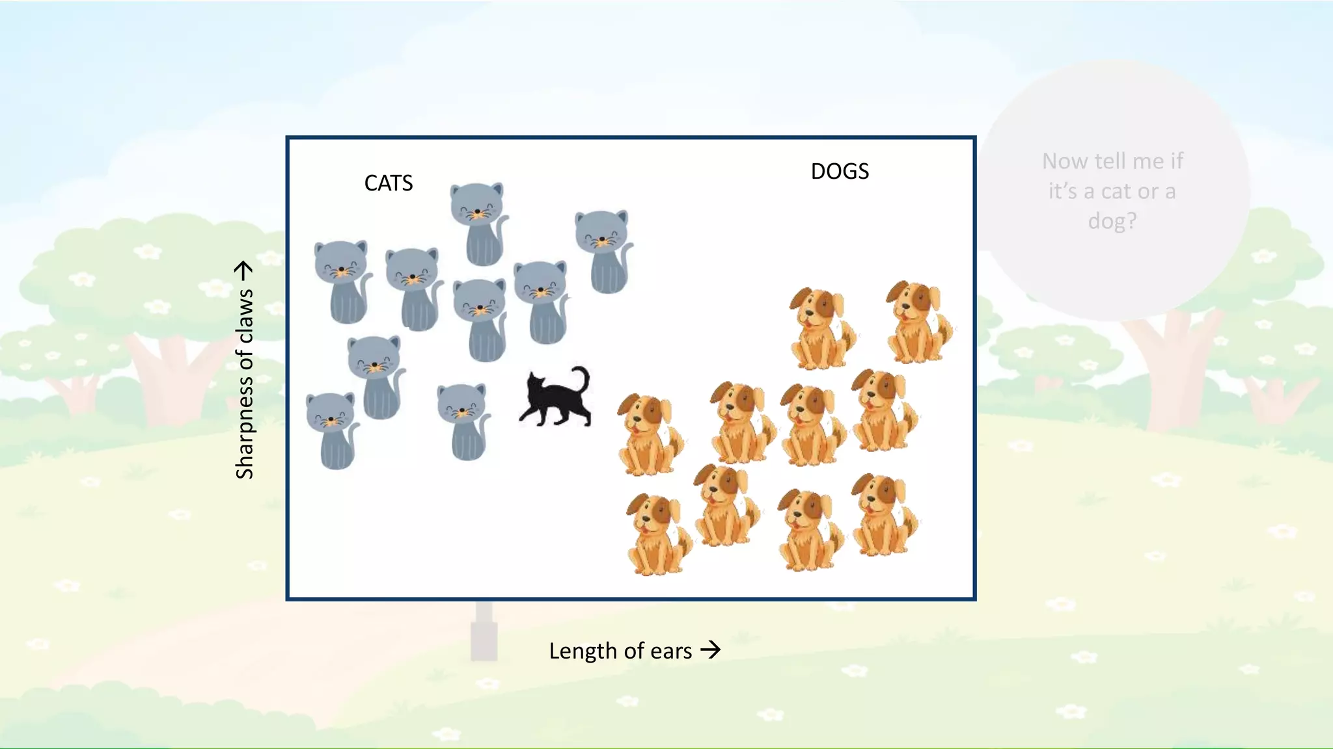
Notes:
Have you asked yourself the question, why do people organize?
Lets go to the psychology of organizing
This predictability applies within the context of our homes, manifesting through the concept of organization

Slide 9
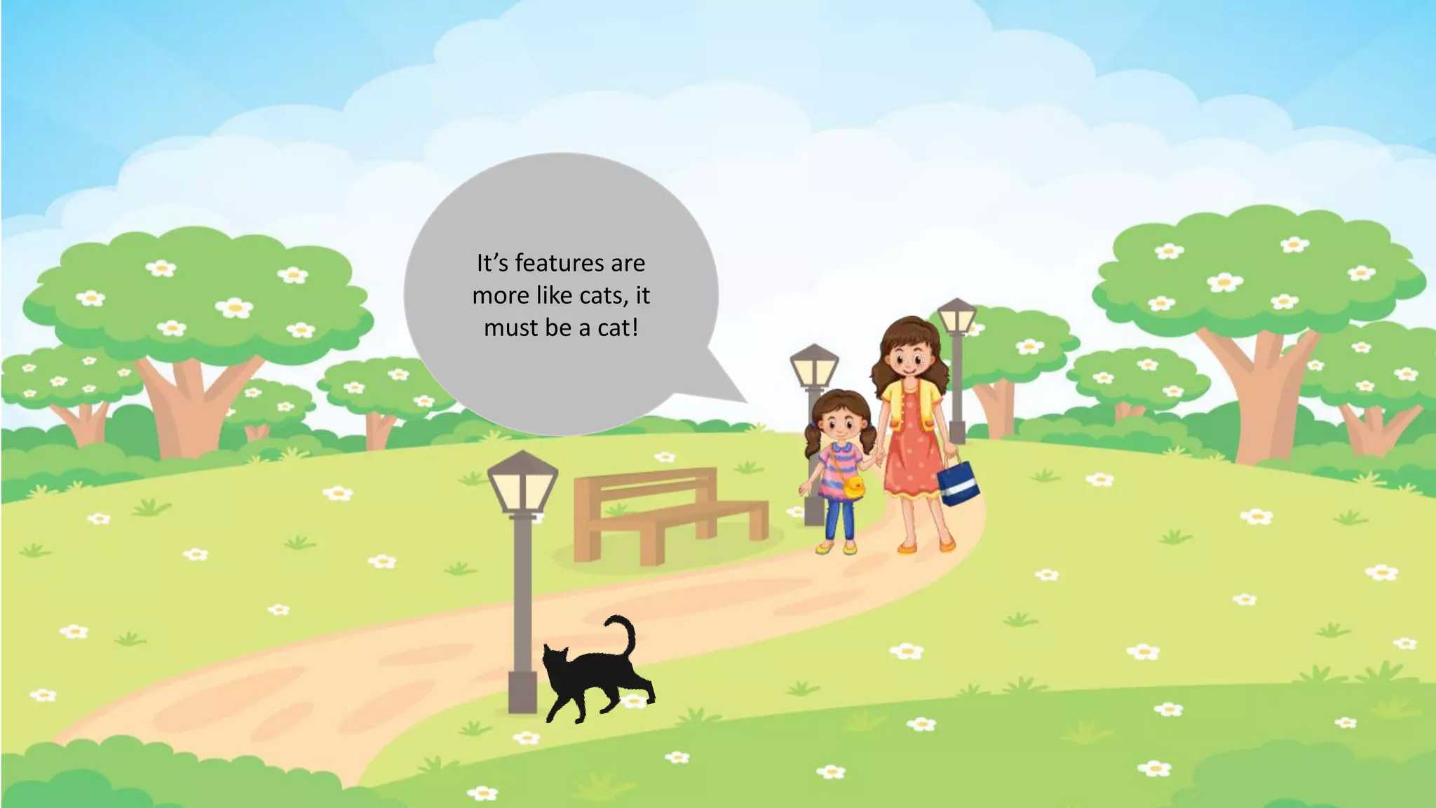
Notes:
Have you asked yourself the question, why do people organize?
Lets go to the psychology of organizing
This predictability applies within the context of our homes, manifesting through the concept of organization

Slide 10
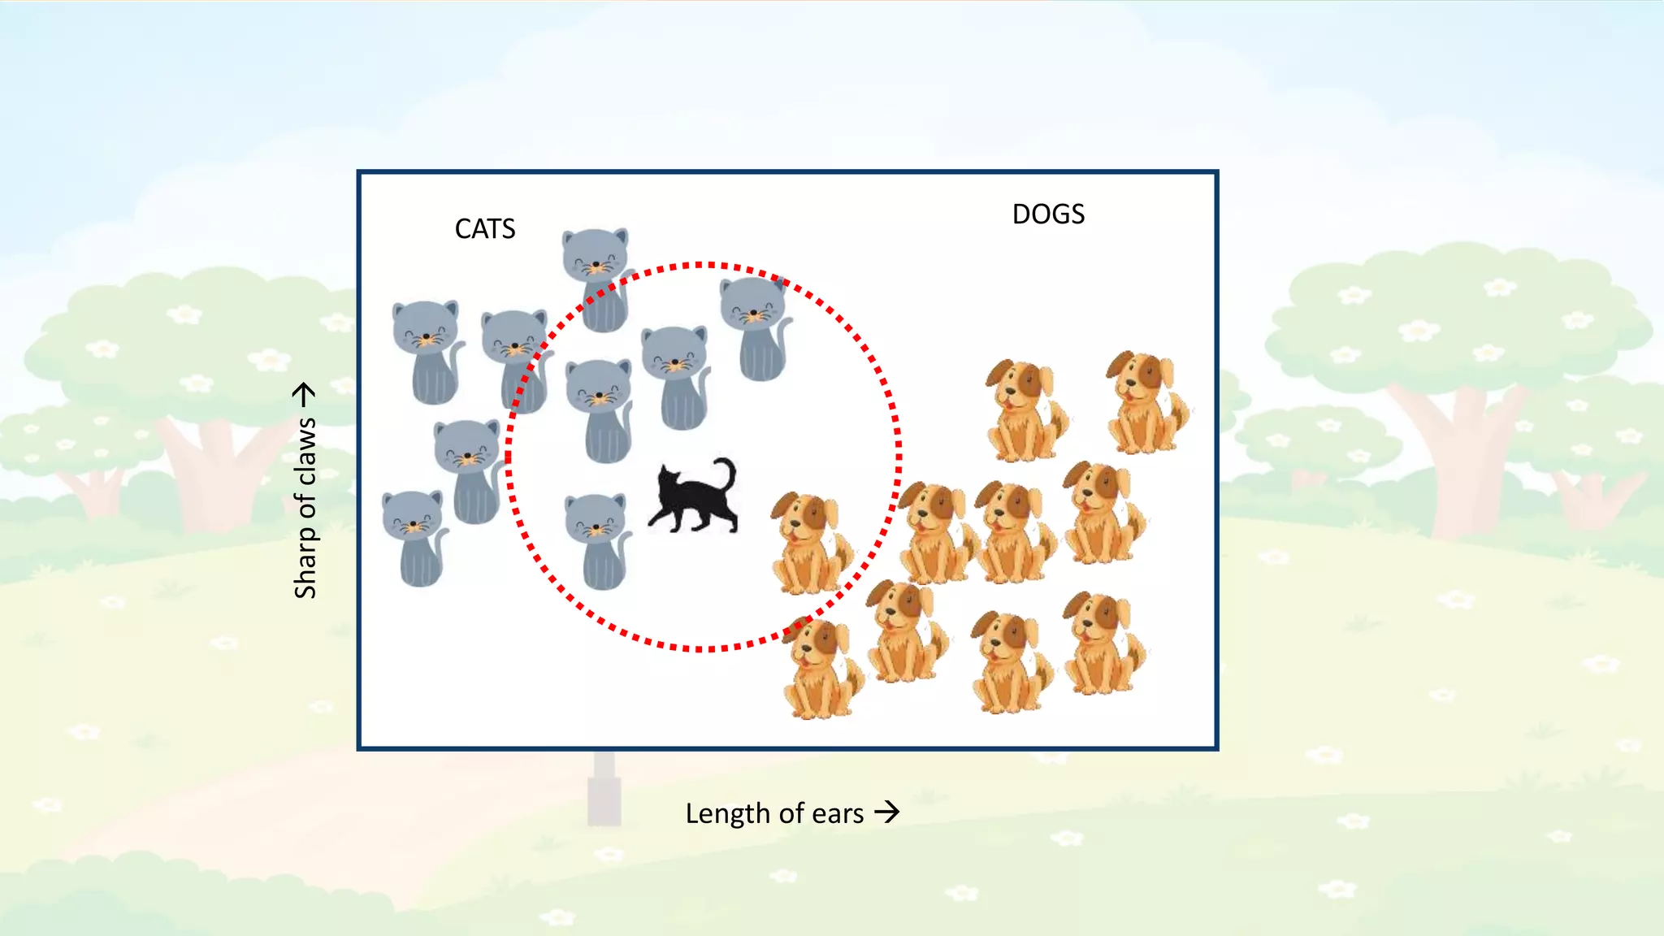
Notes:
Have you asked yourself the question, why do people organize?
Lets go to the psychology of organizing
This predictability applies within the context of our homes, manifesting through the concept of organization

Slide 11
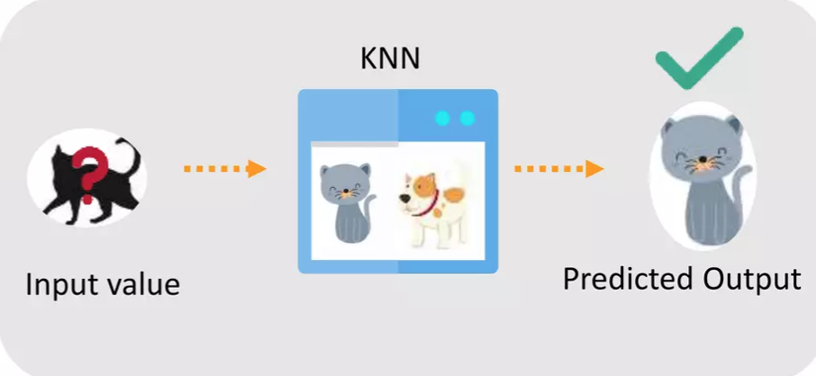
Because KNN is based on feature similarity, we can do classification using KNN
Notes:
Have you asked yourself the question, why do people organize?
Lets go to the psychology of organizing
This predictability applies within the context of our homes, manifesting through the concept of organization

Slide 12

Why do we need KNN?
What is KNN?
How do we choose the factor “K”?
When do we use KNN?
How does the KNN Algorithm work?
Use Case: Predict Diabetes
Notes:
Have you asked yourself the question, why do people organize?
Lets go to the psychology of organizing
This predictability applies within the context of our homes, manifesting through the concept of organization

Slide 13
What is KNN?
KNN or k-Nearest Neighbor is a supervised machine learning algorithm mostly used for classification.
It classifies a data point based on how its neighbors are classified
Notes:
Have you asked yourself the question, why do people organize?
Lets go to the psychology of organizing
This predictability applies within the context of our homes, manifesting through the concept of organization

Slide 14
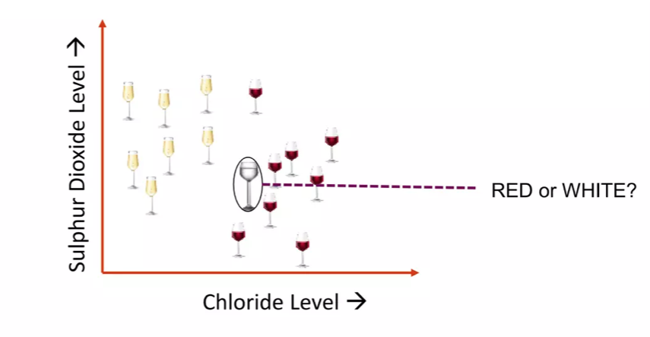
What is KNN?
KNN stores all available cases and classifies new cases based on a similarity measure
Notes:
Have you asked yourself the question, why do people organize?
Lets go to the psychology of organizing
This predictability applies within the context of our homes, manifesting through the concept of organization

Slide 15
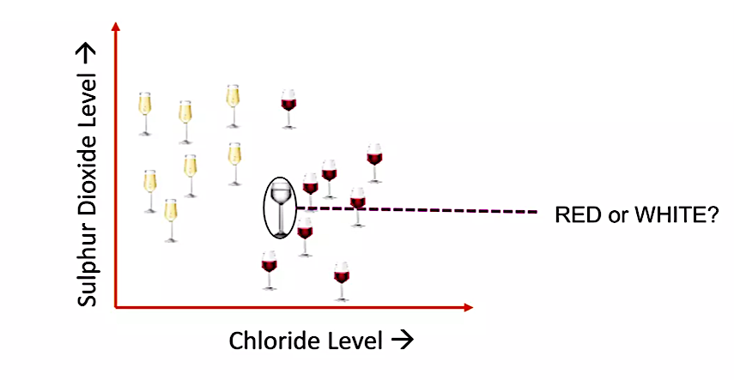
What is KNN?
Notes:
Have you asked yourself the question, why do people organize?
Lets go to the psychology of organizing
This predictability applies within the context of our homes, manifesting through the concept of organization

Slide 16
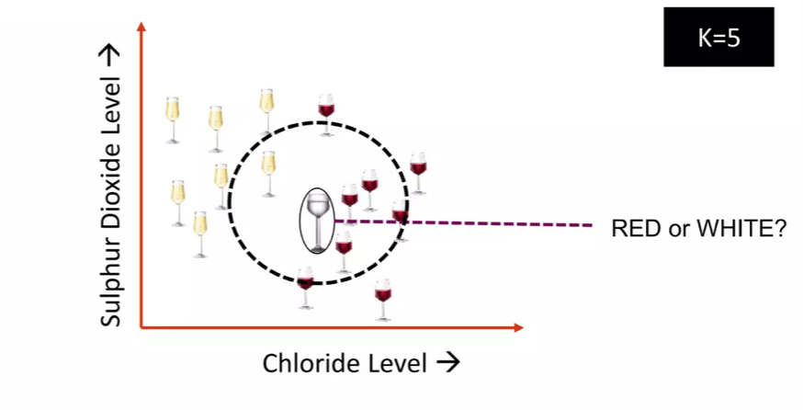
What is KNN?
K in KNN is a parameter that refers to the number of nearest neighbors to include in the majority voting process
Notes:
Have you asked yourself the question, why do people organize?
Lets go to the psychology of organizing
This predictability applies within the context of our homes, manifesting through the concept of organization

Slide 17
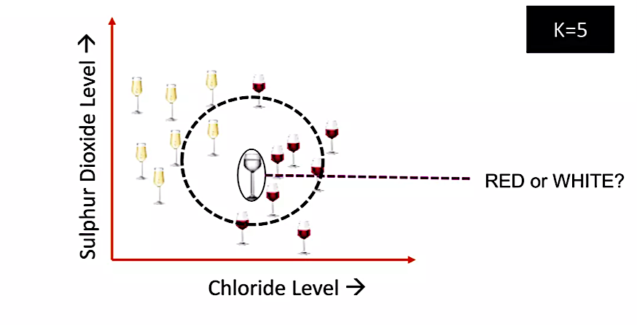
What is KNN?
K in KNN is a parameter that refers to the number of nearest neighbors to include in the majority voting process
Notes:
Have you asked yourself the question, why do people organize?
Lets go to the psychology of organizing
This predictability applies within the context of our homes, manifesting through the concept of organization

Slide 18
What is KNN?
A data point is classified by majority votes from its 5 nearest neighbors
Notes:
Have you asked yourself the question, why do people organize?
Lets go to the psychology of organizing
This predictability applies within the context of our homes, manifesting through the concept of organization

Slide 19
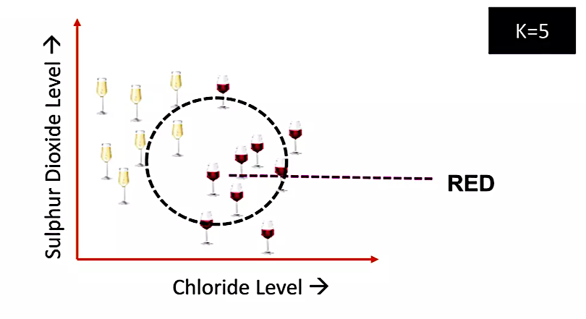
What is KNN?
Notes:
Have you asked yourself the question, why do people organize?
Lets go to the psychology of organizing
This predictability applies within the context of our homes, manifesting through the concept of organization

Slide 20
Why do we need KNN?
What is KNN?
How do we choose the factor “K”?
When do we use KNN?
How does the KNN Algorithm work?
Use Case: Predict Diabetes
Notes:
Have you asked yourself the question, why do people organize?
Lets go to the psychology of organizing
This predictability applies within the context of our homes, manifesting through the concept of organization

Slide 21
How do we choose ”K”?
KNN is based on feature similarity.
Choosing the right ”K” is a process of parameter tuning and it is important for better accuracy
Notes:
Have you asked yourself the question, why do people organize?
Lets go to the psychology of organizing
This predictability applies within the context of our homes, manifesting through the concept of organization

Slide 22
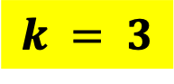
$$k = 3$$
?
When $k$ = 3, we can classify the new data point as
Notes:
Have you asked yourself the question, why do people organize?
Lets go to the psychology of organizing
This predictability applies within the context of our homes, manifesting through the concept of organization

Slide 23
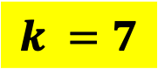
$$k =7$$
$$k = 3$$
?
But when $k$ = 7, we can classify the new data point as
Notes:
Have you asked yourself the question, why do people organize?
Lets go to the psychology of organizing
This predictability applies within the context of our homes, manifesting through the concept of organization

Slide 24
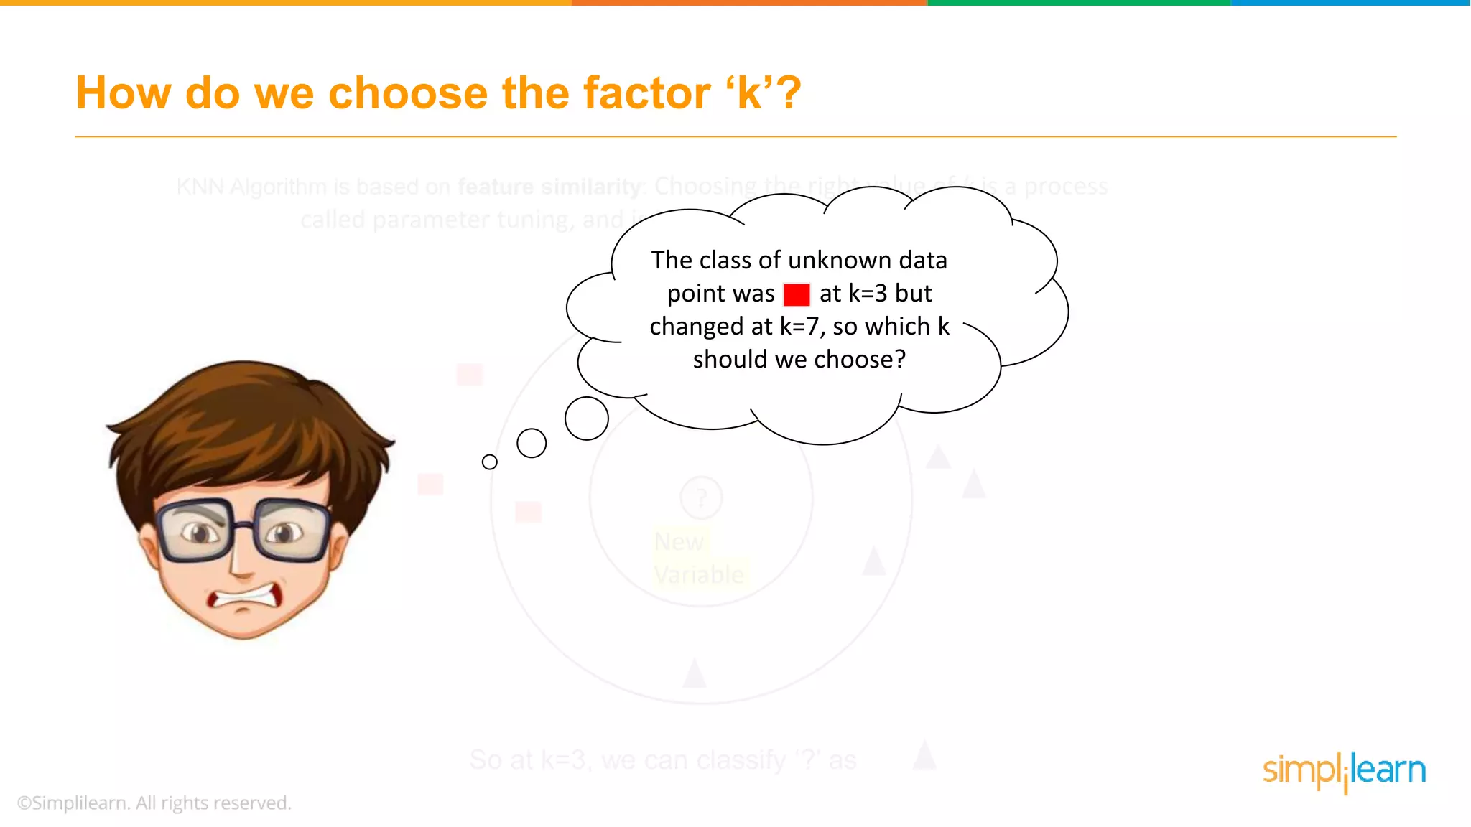
Notes:
Have you asked yourself the question, why do people organize?
Lets go to the psychology of organizing
This predictability applies within the context of our homes, manifesting through the concept of organization

Slide 25
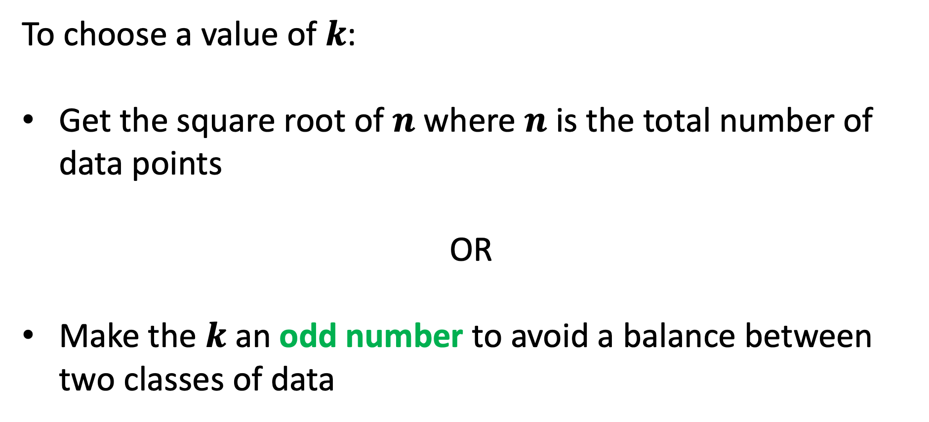
How do we choose ”K”?
To choose a value of $k$:
Get the square root of $n$ where $n$ is the total number of data points
OR
Make the $k$ an odd number to avoid a balance between two classes of data
Notes:
Have you asked yourself the question, why do people organize?
Lets go to the psychology of organizing
This predictability applies within the context of our homes, manifesting through the concept of organization

Slide 26
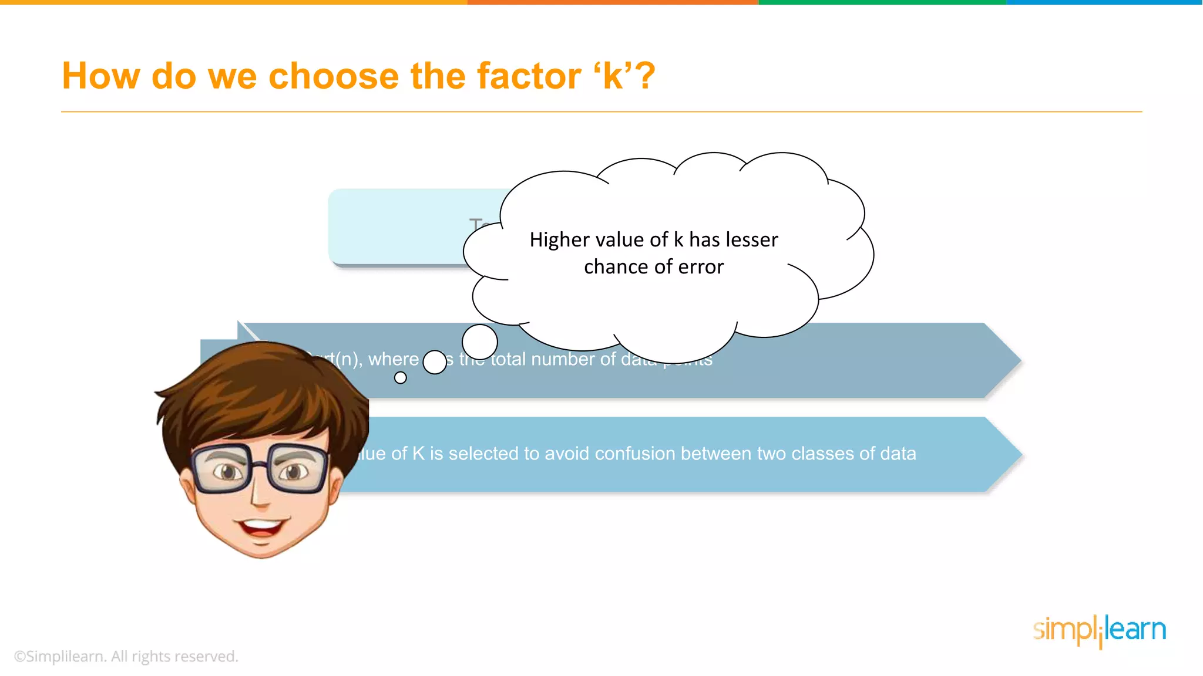
Notes:
Have you asked yourself the question, why do people organize?
Lets go to the psychology of organizing
This predictability applies within the context of our homes, manifesting through the concept of organization

Slide 27
Why do we need KNN?
What is KNN?
How do we choose the factor “K”?
When do we use KNN?
How does the KNN Algorithm work?
Use Case: Predict Diabetes
Notes:
Have you asked yourself the question, why do people organize?
Lets go to the psychology of organizing
This predictability applies within the context of our homes, manifesting through the concept of organization

Slide 28
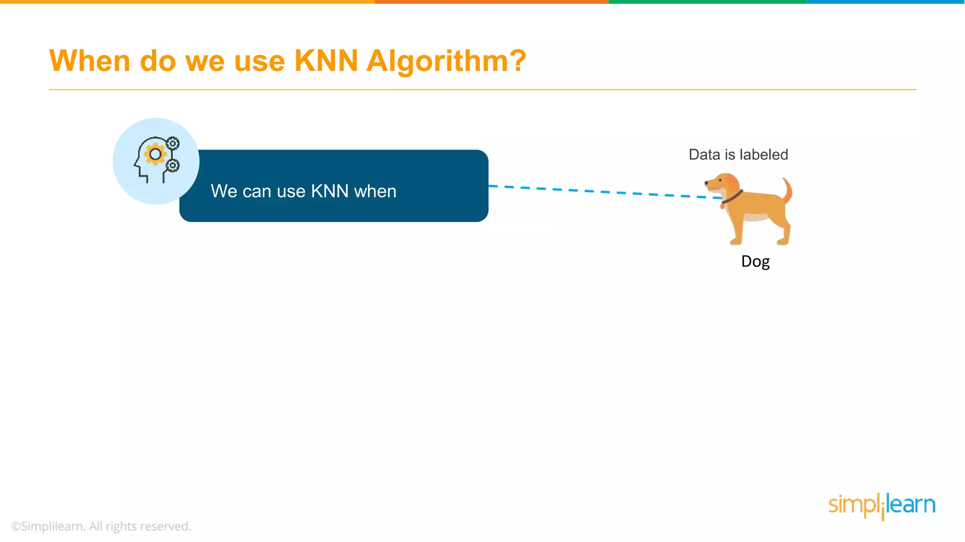
Notes:
Have you asked yourself the question, why do people organize?
Lets go to the psychology of organizing
This predictability applies within the context of our homes, manifesting through the concept of organization

Slide 29
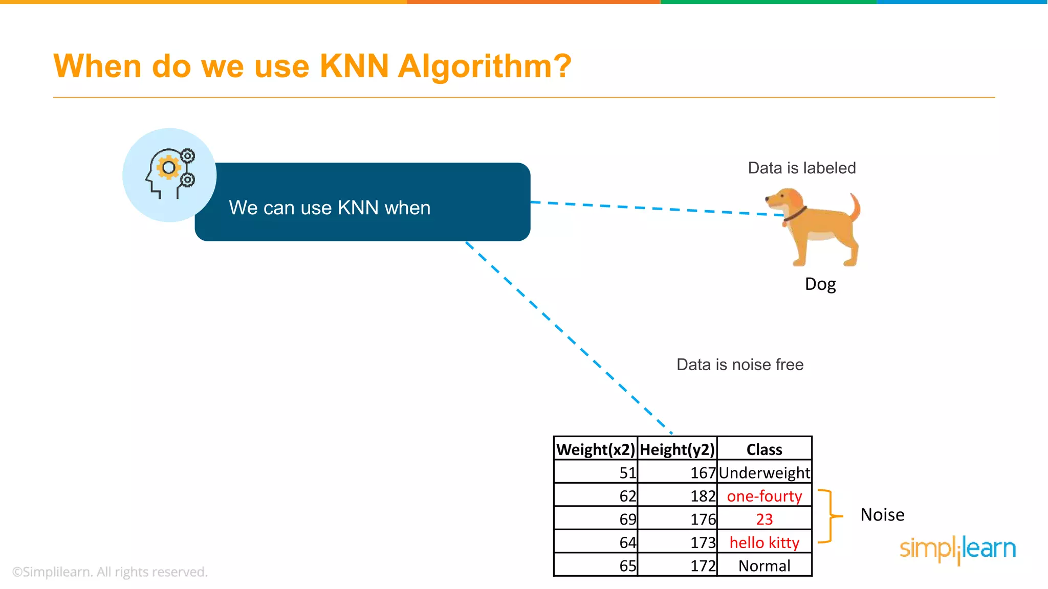
Notes:
Have you asked yourself the question, why do people organize?
Lets go to the psychology of organizing
This predictability applies within the context of our homes, manifesting through the concept of organization

Slide 30
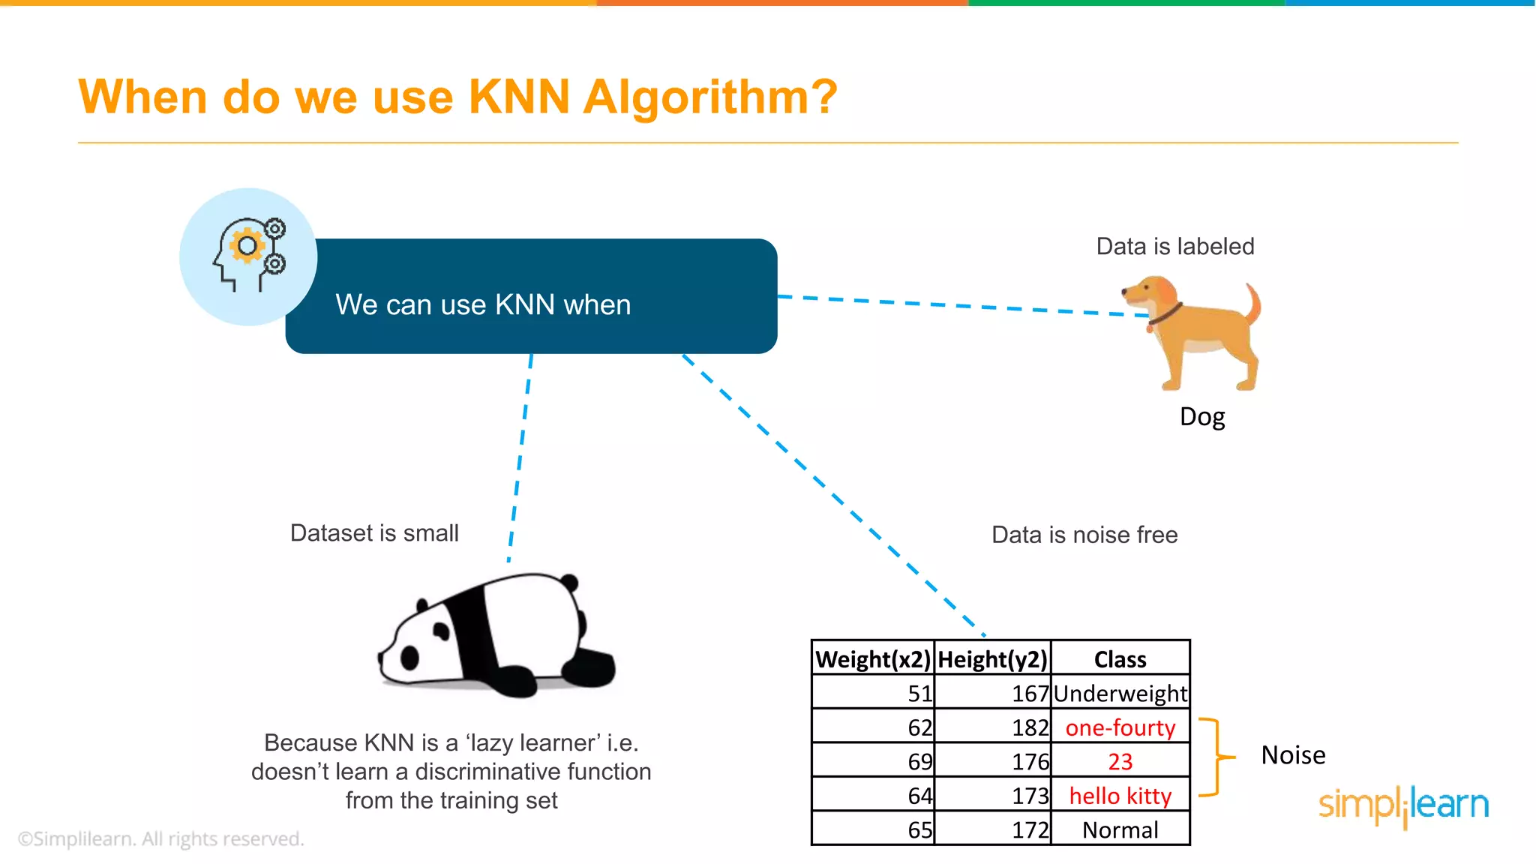
Notes:
Have you asked yourself the question, why do people organize?
Lets go to the psychology of organizing
This predictability applies within the context of our homes, manifesting through the concept of organization

Slide 31
Why do we need KNN?
What is KNN?
How do we choose the factor “K”?
When do we use KNN?
How does the KNN Algorithm work?
Use Case: Predict Diabetes
Notes:
Have you asked yourself the question, why do people organize?
Lets go to the psychology of organizing
This predictability applies within the context of our homes, manifesting through the concept of organization

Slide 32
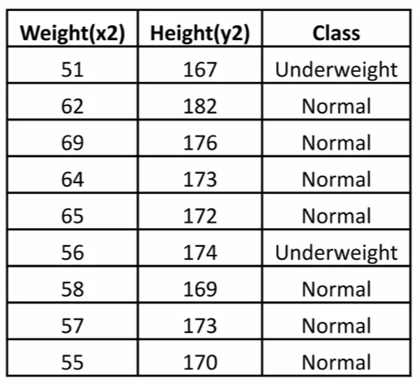
How does the KNN Algorithm work?
Consider the dataset having two variables: height(cm) and weight(kg) and each datapoint is classified as Normal or Underweight
Notes:
Have you asked yourself the question, why do people organize?
Lets go to the psychology of organizing
This predictability applies within the context of our homes, manifesting through the concept of organization

Slide 33
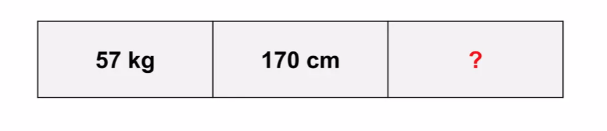
How does the KNN Algorithm work?
Assuming we do not know how to calculate the body mass index (BMI), we need to classify this unseen data as Normal or Underweight
Notes:
Have you asked yourself the question, why do people organize?
Lets go to the psychology of organizing
This predictability applies within the context of our homes, manifesting through the concept of organization

Slide 34
How does the KNN Algorithm work?
KNN finds the nearest neighbor by calculating the Euclidean distance
Notes:
Have you asked yourself the question, why do people organize?
Lets go to the psychology of organizing
This predictability applies within the context of our homes, manifesting through the concept of organization

Slide 35
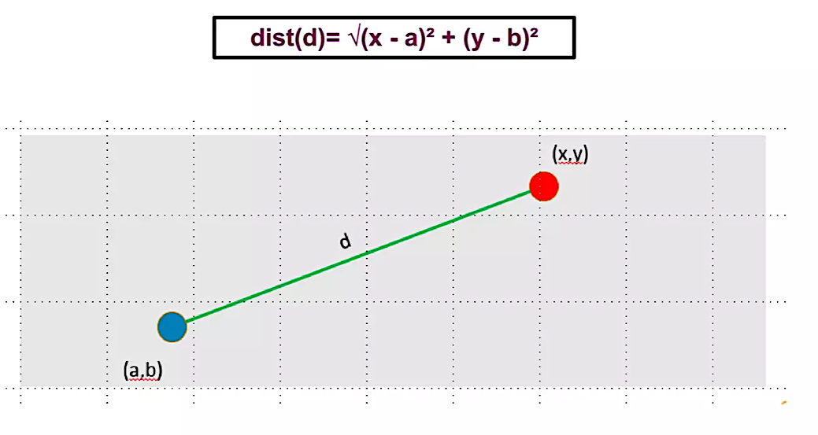
How does the KNN Algorithm work?
According to the Euclidean distance formula, the distance between two points is given by:
Notes:
Have you asked yourself the question, why do people organize?
Lets go to the psychology of organizing
This predictability applies within the context of our homes, manifesting through the concept of organization

Slide 36
Notes:
Have you asked yourself the question, why do people organize?
Lets go to the psychology of organizing
This predictability applies within the context of our homes, manifesting through the concept of organization

Slide 37
d1
dist(d1) = √ (170-167)²- (57-51)²
dist(d1) = 6.7
Notes:
Have you asked yourself the question, why do people organize?
Lets go to the psychology of organizing
This predictability applies within the context of our homes, manifesting through the concept of organization

Slide 38
d1
dist(d2) = √ (170-182)²- (57-62)²
dist(d2) = 13
Notes:
Have you asked yourself the question, why do people organize?
Lets go to the psychology of organizing
This predictability applies within the context of our homes, manifesting through the concept of organization

Slide 39
d1
dist(d3) = √ (170-176)²- (57-69)²
dist(d3) = 13.4
Notes:
Have you asked yourself the question, why do people organize?
Lets go to the psychology of organizing
This predictability applies within the context of our homes, manifesting through the concept of organization

Slide 40
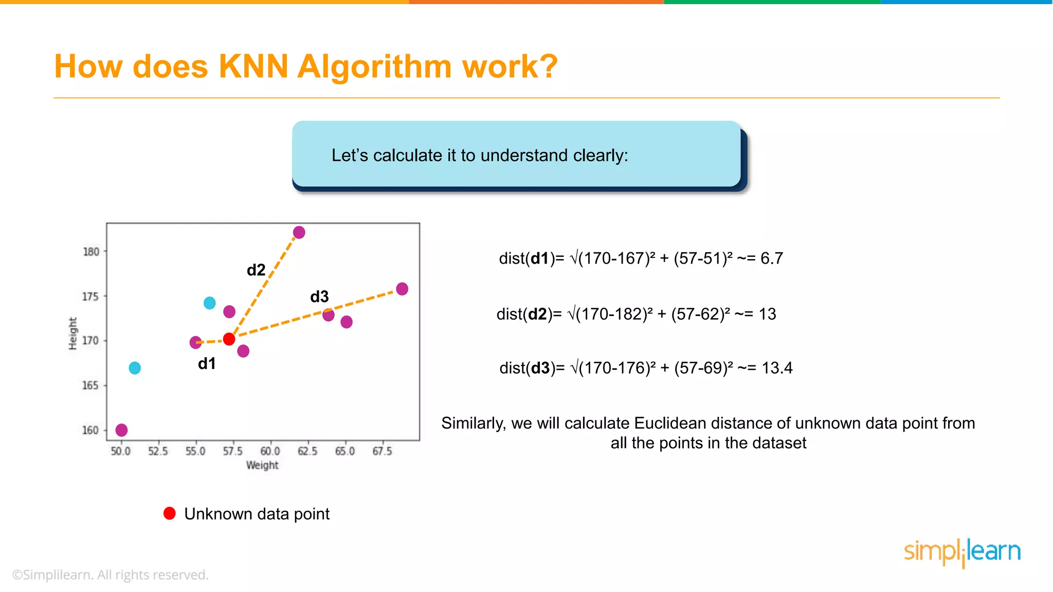
Notes:
Have you asked yourself the question, why do people organize?
Lets go to the psychology of organizing
This predictability applies within the context of our homes, manifesting through the concept of organization

Slide 41
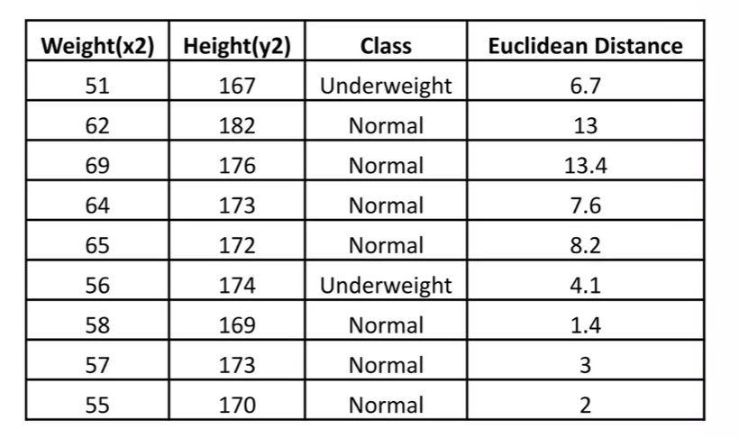
How does the KNN Algorithm work?
We calculate the Euclidean distance of unknown datapoints from all the points in the dataset
Notes:
Have you asked yourself the question, why do people organize?
Lets go to the psychology of organizing
This predictability applies within the context of our homes, manifesting through the concept of organization

Slide 42
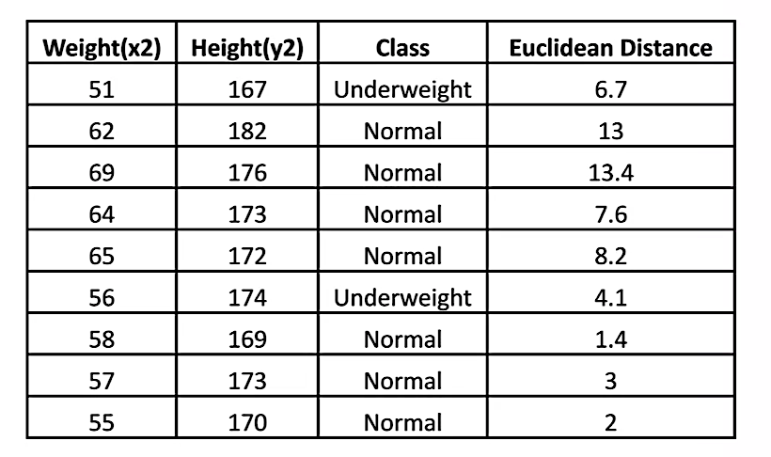



Notes:
Have you asked yourself the question, why do people organize?
Lets go to the psychology of organizing
This predictability applies within the context of our homes, manifesting through the concept of organization

Slide 43
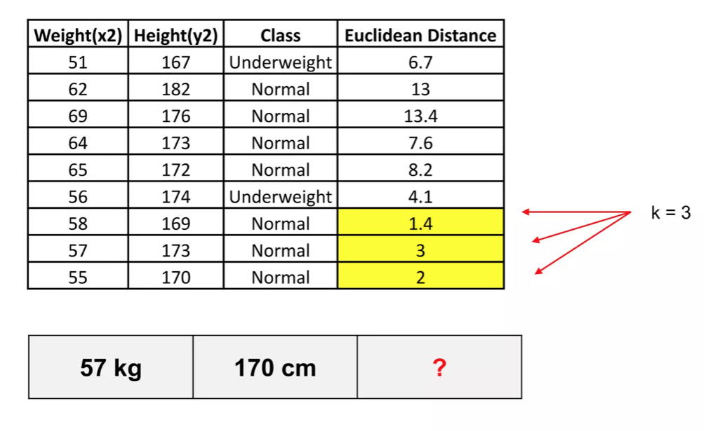
How does the KNN Algorithm work?
Let us calculate the nearest neighbor at k=3
Notes:
Have you asked yourself the question, why do people organize?
Lets go to the psychology of organizing
This predictability applies within the context of our homes, manifesting through the concept of organization

Slide 44
How does the KNN Algorithm work?
Notes:
Have you asked yourself the question, why do people organize?
Lets go to the psychology of organizing
This predictability applies within the context of our homes, manifesting through the concept of organization

Slide 45
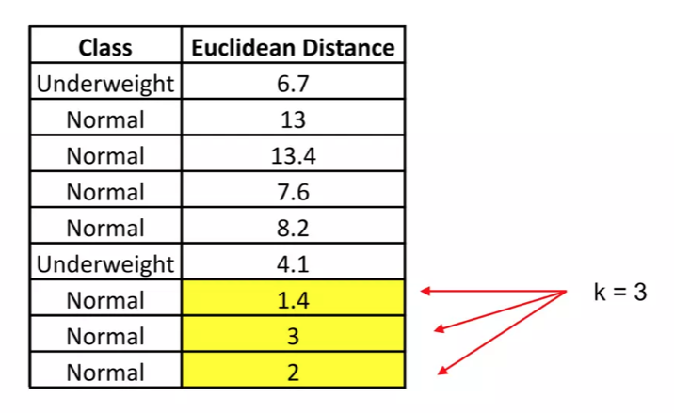
How does the KNN Algorithm work?
The majority of its neighbors are Normal.
Hence, having a weight of 57 kg and a height of 170 cm is Normal
57 kg | 170 cm | Normal
Notes:
Have you asked yourself the question, why do people organize?
Lets go to the psychology of organizing
This predictability applies within the context of our homes, manifesting through the concept of organization

Slide 46
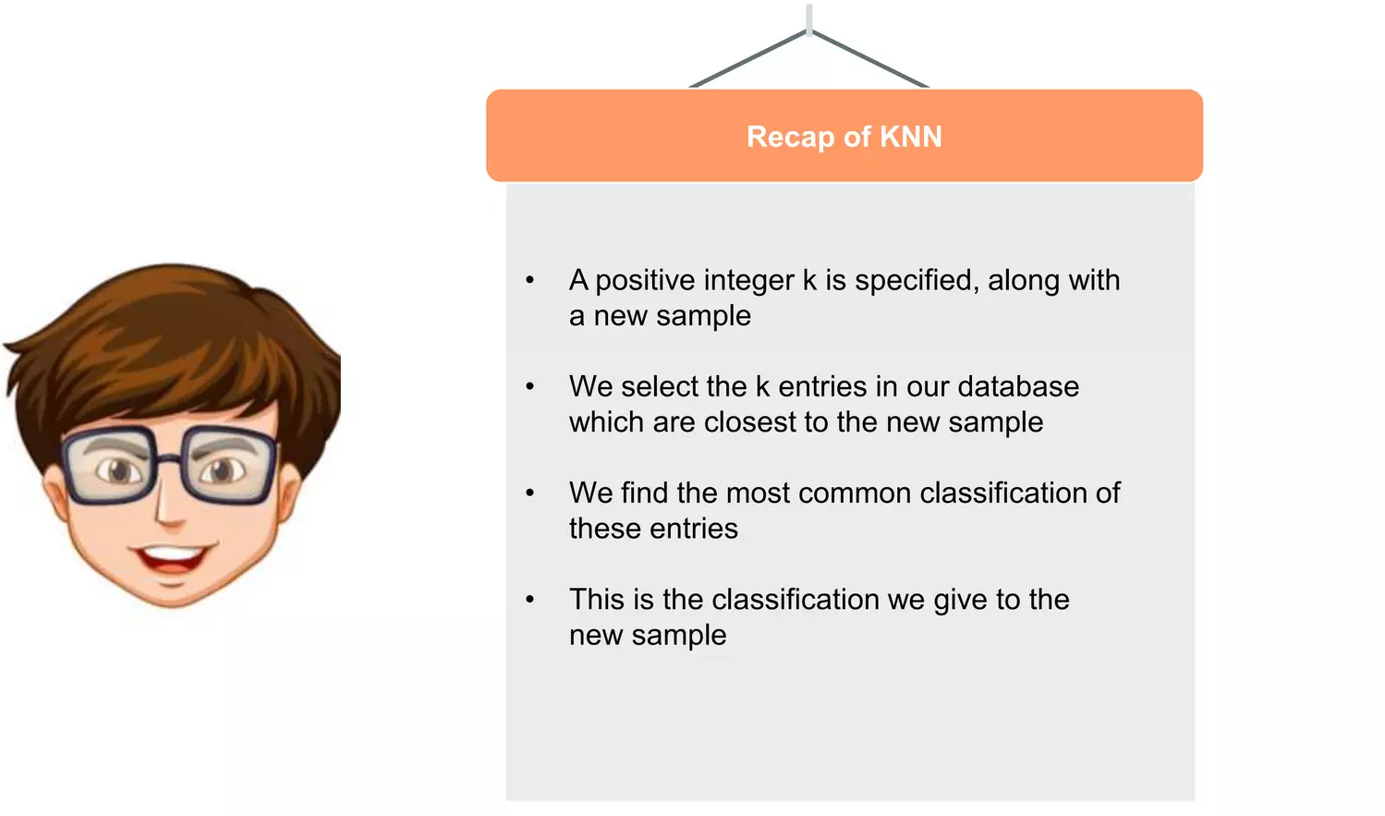
Notes:
Have you asked yourself the question, why do people organize?
Lets go to the psychology of organizing
This predictability applies within the context of our homes, manifesting through the concept of organization

Slide 47
Why do we need KNN?
What is KNN?
How do we choose the factor “K”?
When do we use KNN?
How does the KNN Algorithm work?
Use Case: Predict Diabetes
Notes:
Have you asked yourself the question, why do people organize?
Lets go to the psychology of organizing
This predictability applies within the context of our homes, manifesting through the concept of organization

Slide 48
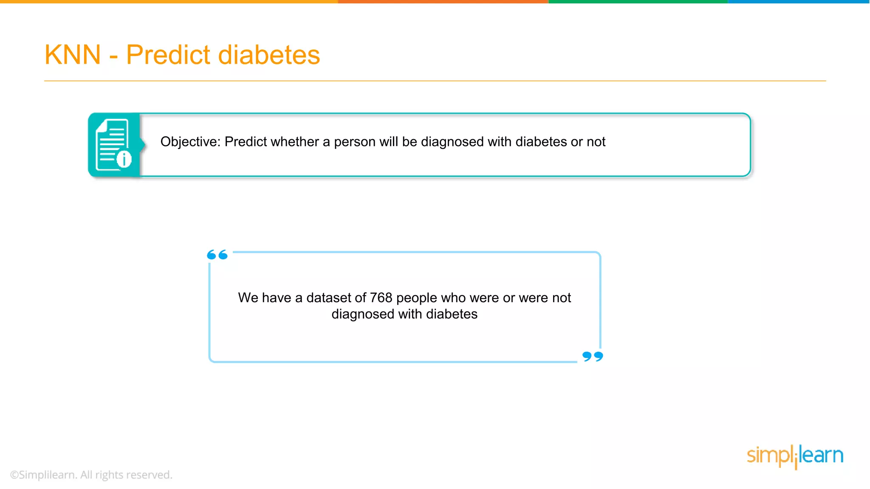
Notes:
Have you asked yourself the question, why do people organize?
Lets go to the psychology of organizing
This predictability applies within the context of our homes, manifesting through the concept of organization

Slide 49
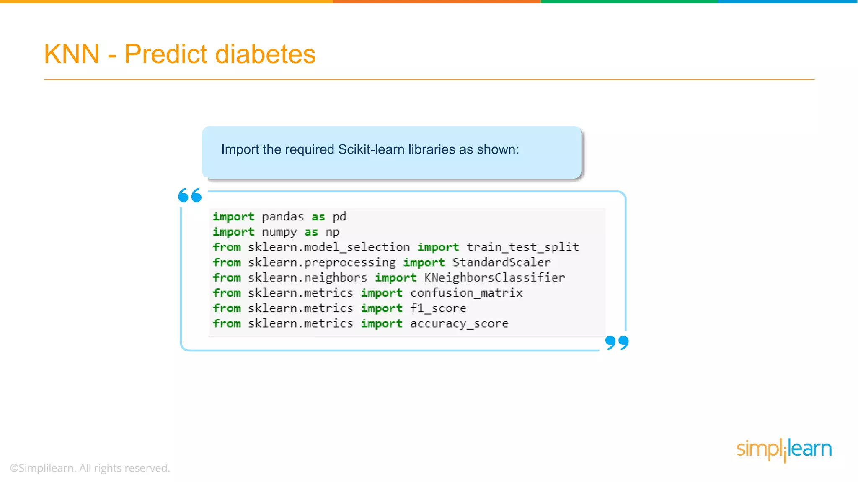
Notes:
Have you asked yourself the question, why do people organize?
Lets go to the psychology of organizing
This predictability applies within the context of our homes, manifesting through the concept of organization

Slide 50
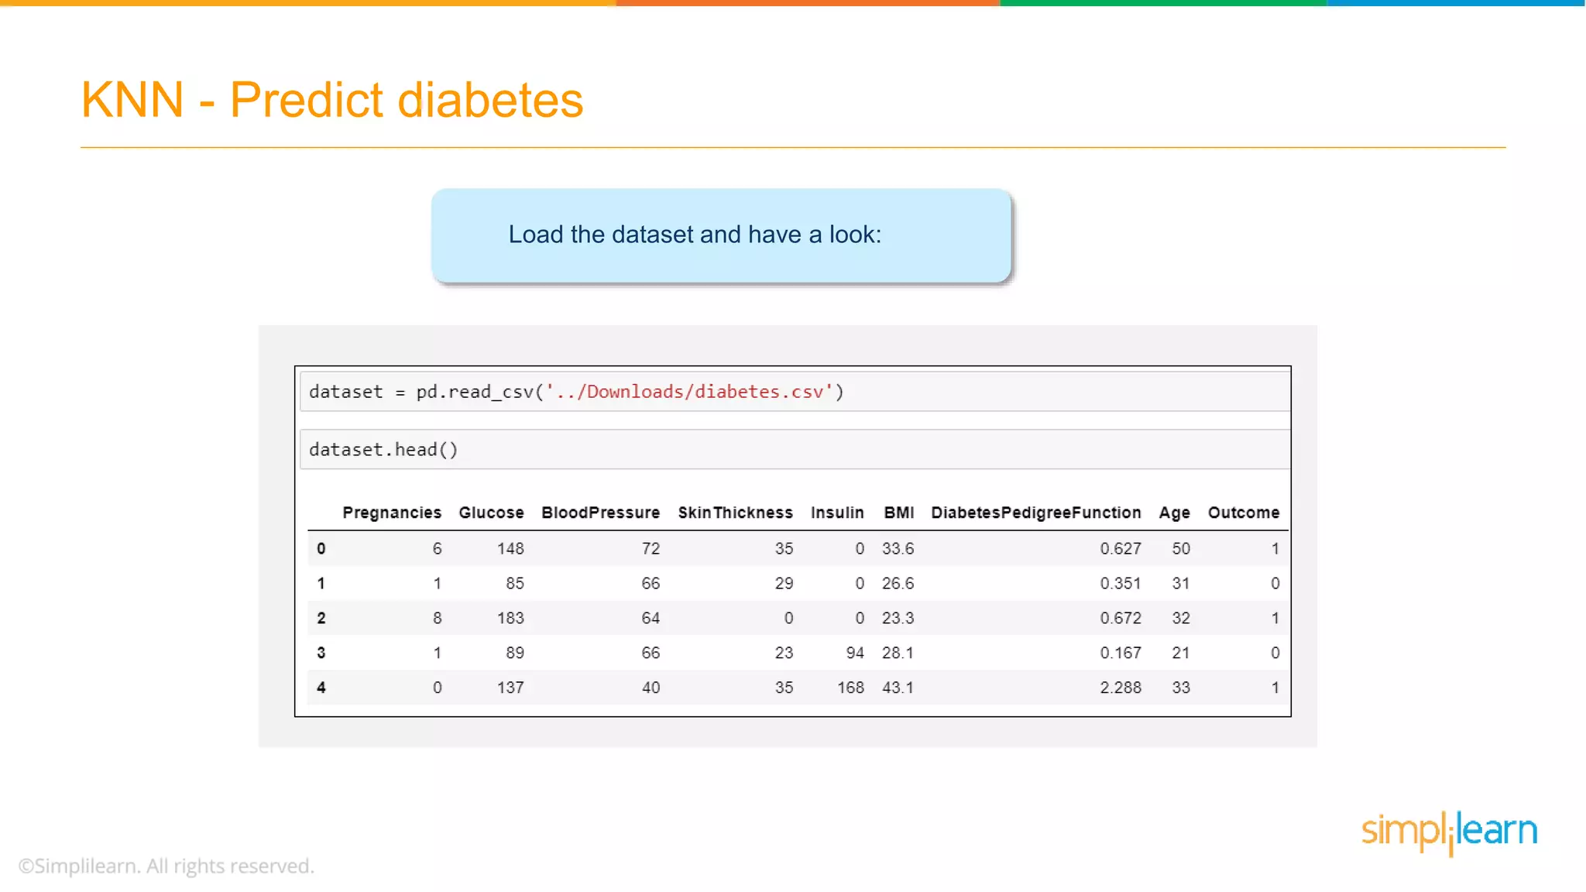
Notes:
Have you asked yourself the question, why do people organize?
Lets go to the psychology of organizing
This predictability applies within the context of our homes, manifesting through the concept of organization

Slide 51
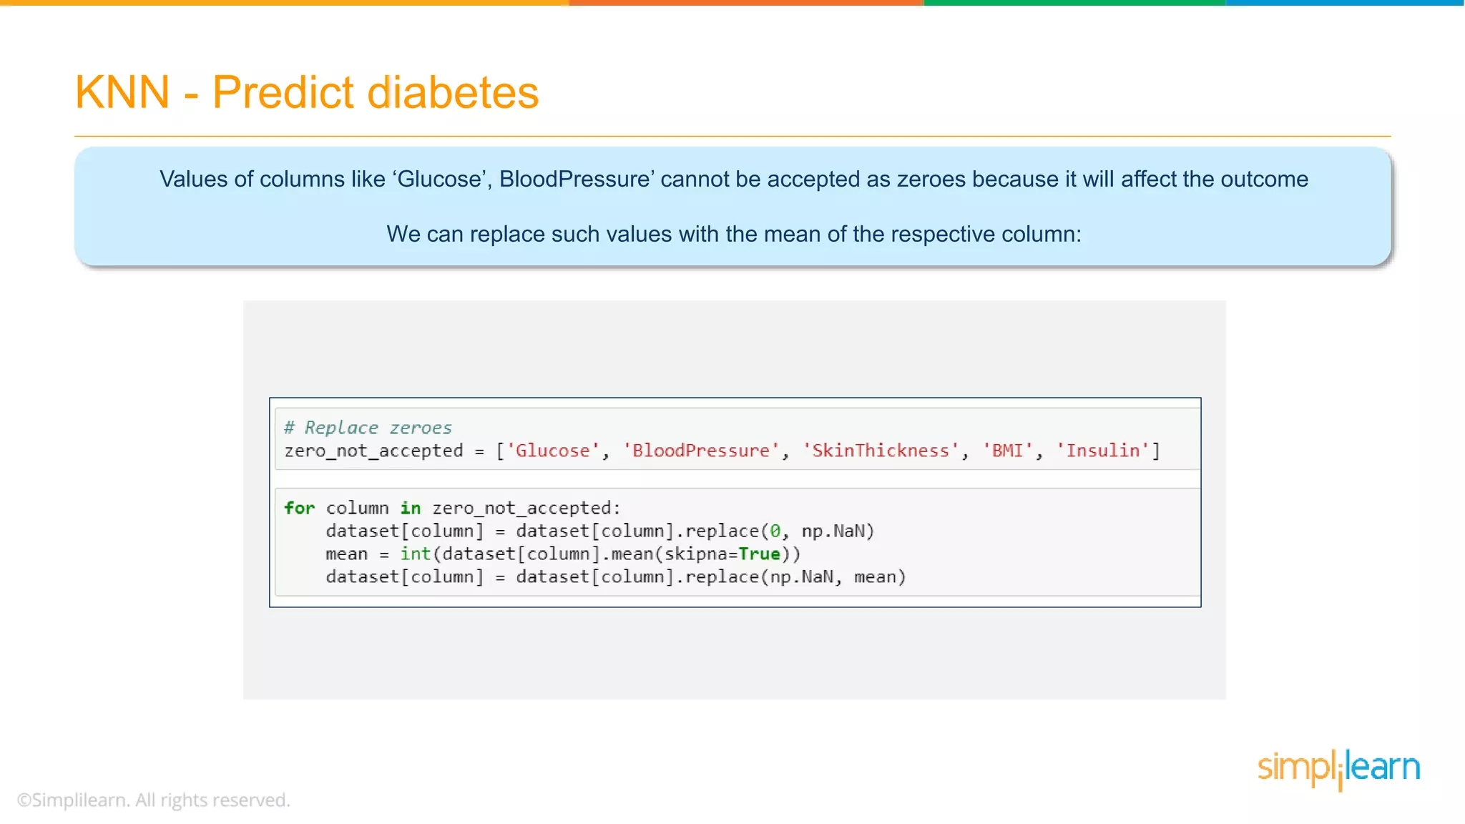
Notes:
Have you asked yourself the question, why do people organize?
Lets go to the psychology of organizing
This predictability applies within the context of our homes, manifesting through the concept of organization

Slide 52
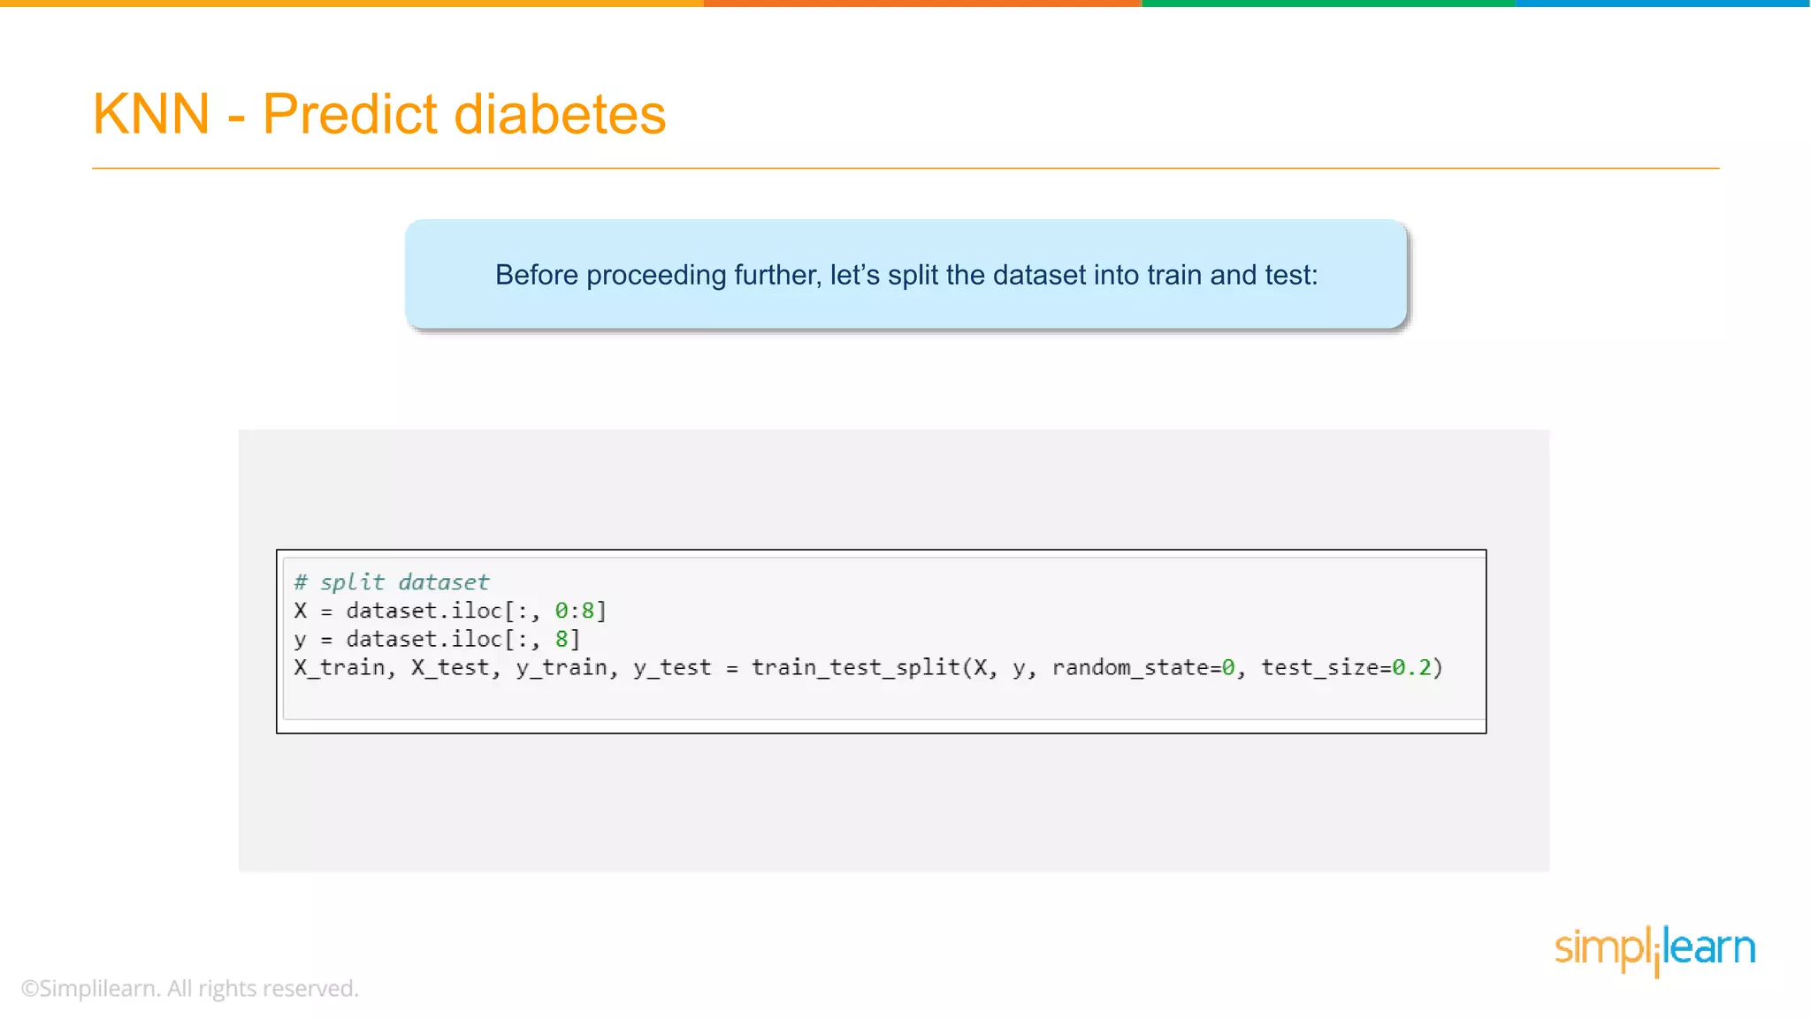
Notes:
Have you asked yourself the question, why do people organize?
Lets go to the psychology of organizing
This predictability applies within the context of our homes, manifesting through the concept of organization

Slide 53
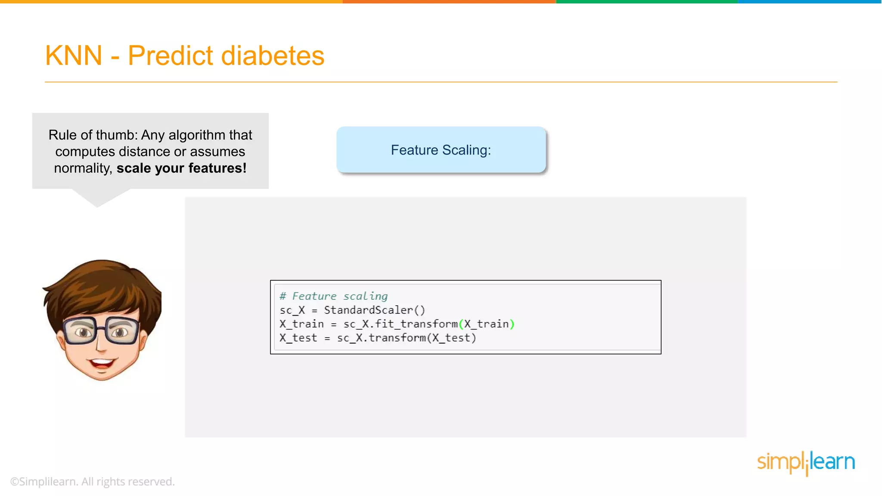
Notes:
Have you asked yourself the question, why do people organize?
Lets go to the psychology of organizing
This predictability applies within the context of our homes, manifesting through the concept of organization

Slide 54
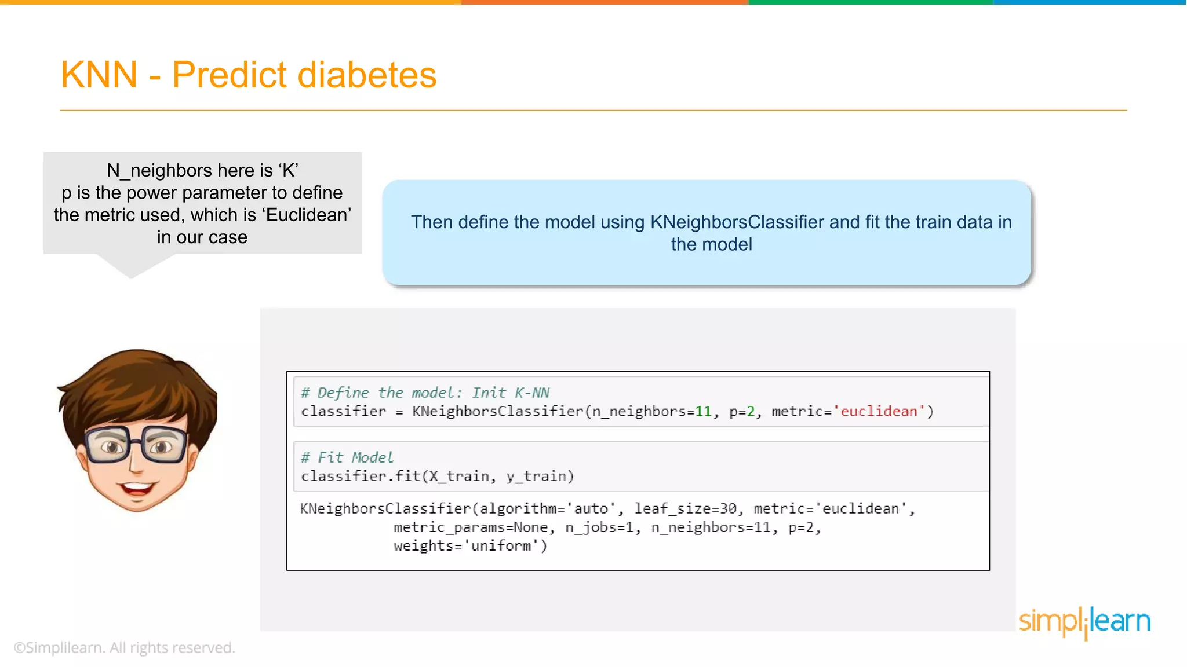
Notes:
Have you asked yourself the question, why do people organize?
Lets go to the psychology of organizing
This predictability applies within the context of our homes, manifesting through the concept of organization

Slide 55
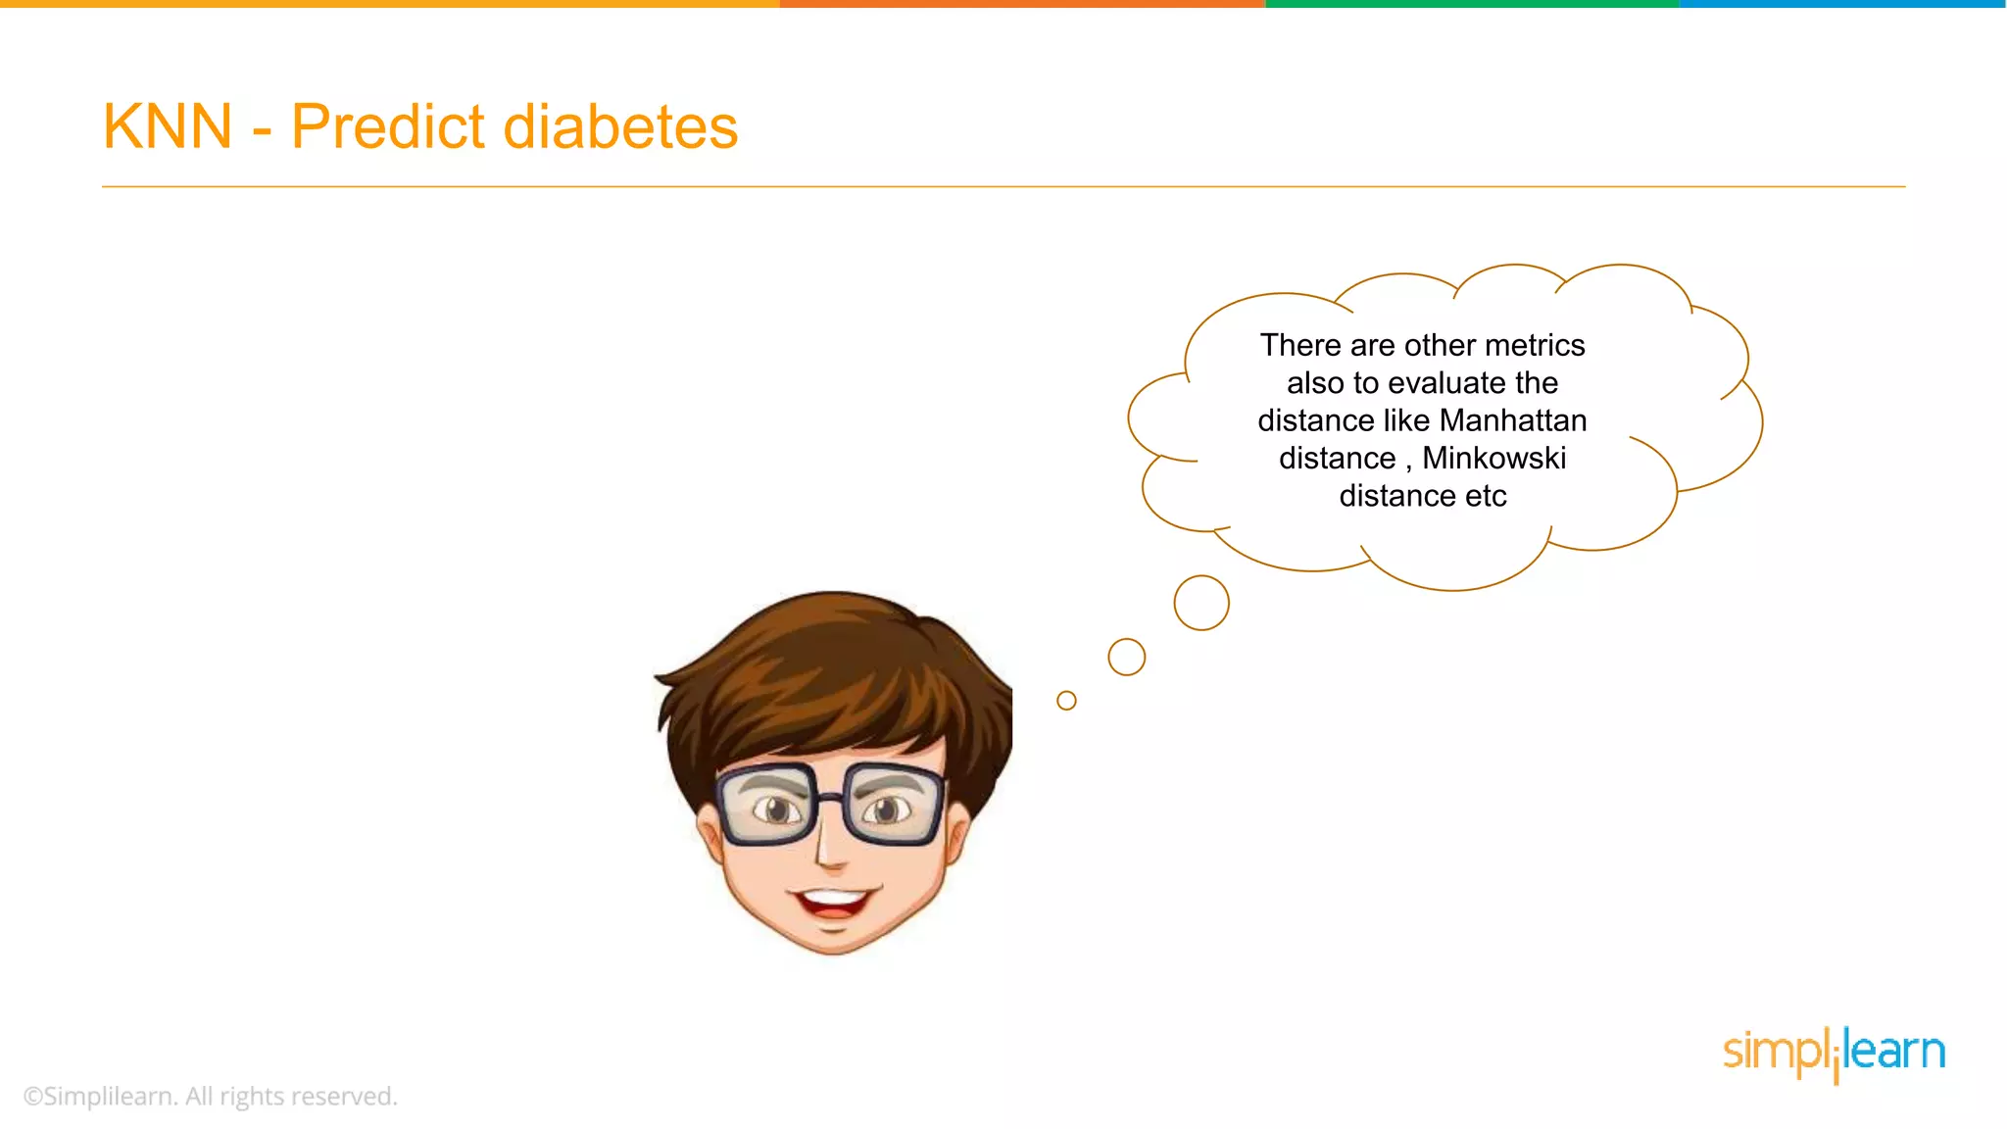
Notes:
Have you asked yourself the question, why do people organize?
Lets go to the psychology of organizing
This predictability applies within the context of our homes, manifesting through the concept of organization

Slide 56
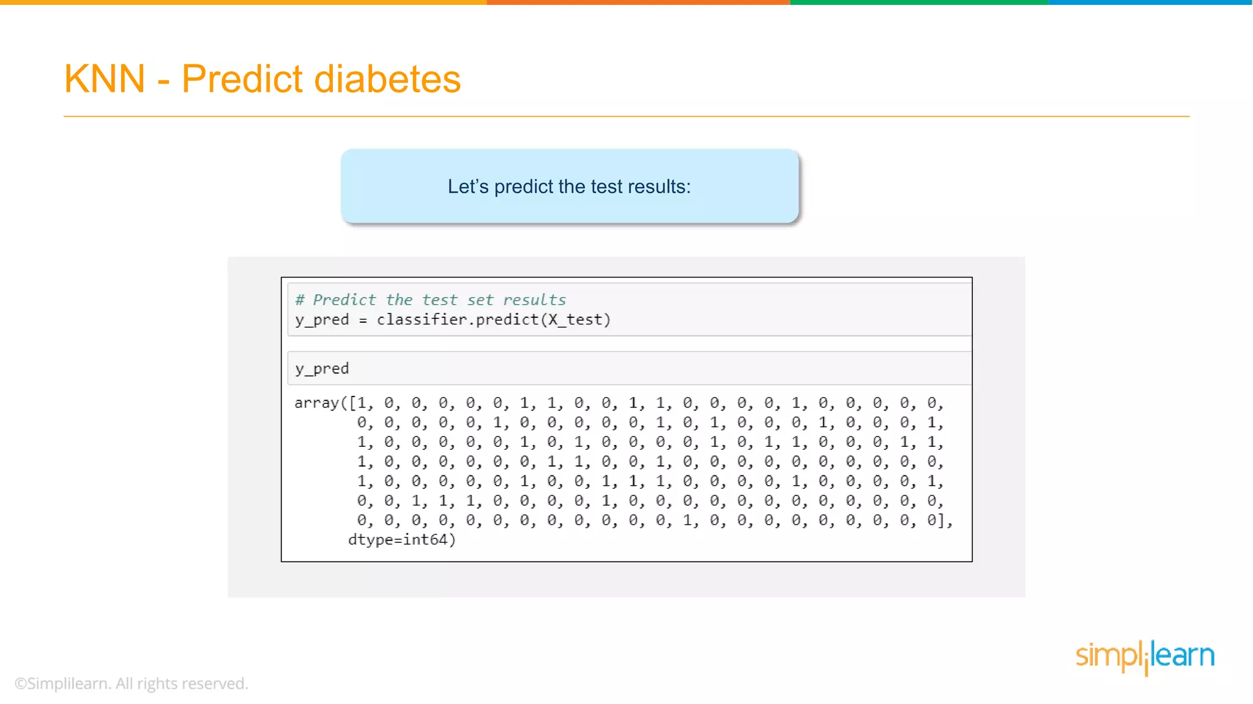
Notes:
Have you asked yourself the question, why do people organize?
Lets go to the psychology of organizing
This predictability applies within the context of our homes, manifesting through the concept of organization

Slide 57
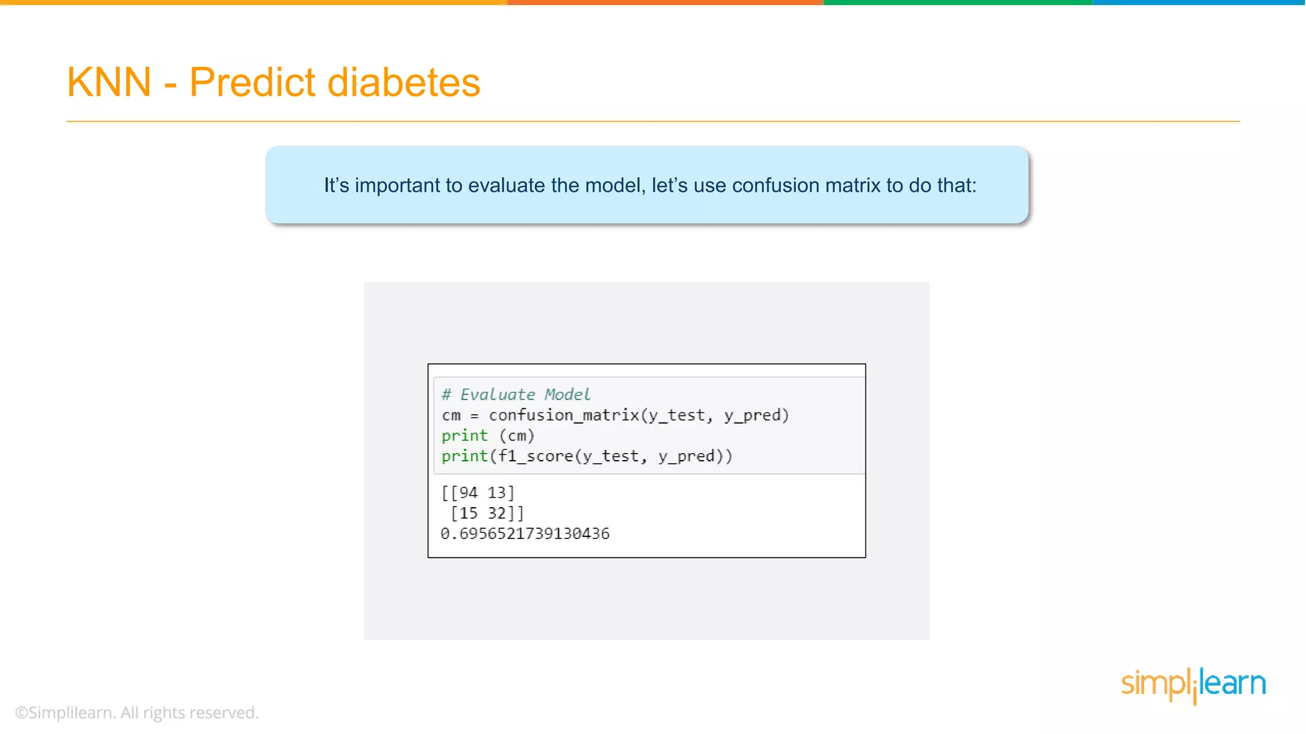
Notes:
Have you asked yourself the question, why do people organize?
Lets go to the psychology of organizing
This predictability applies within the context of our homes, manifesting through the concept of organization

Slide 58
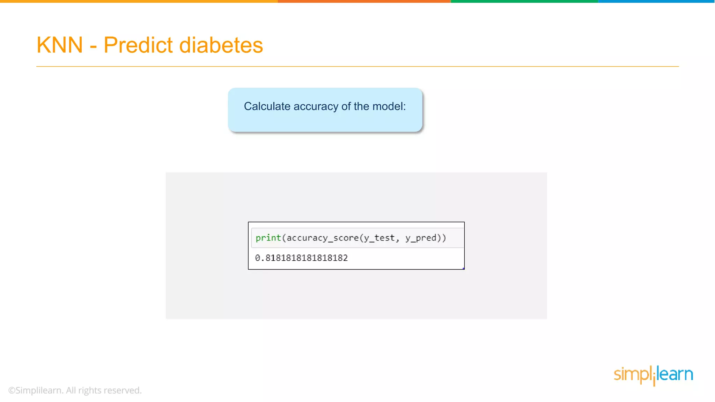
Notes:
Have you asked yourself the question, why do people organize?
Lets go to the psychology of organizing
This predictability applies within the context of our homes, manifesting through the concept of organization

Slide 59
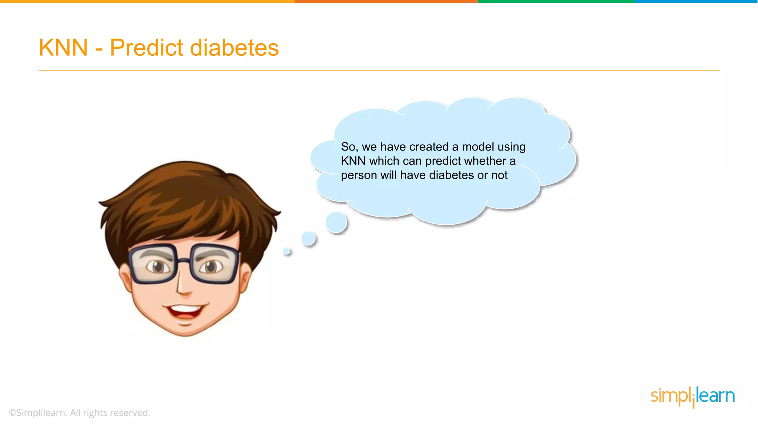
Notes:
Have you asked yourself the question, why do people organize?
Lets go to the psychology of organizing
This predictability applies within the context of our homes, manifesting through the concept of organization

Slide 60
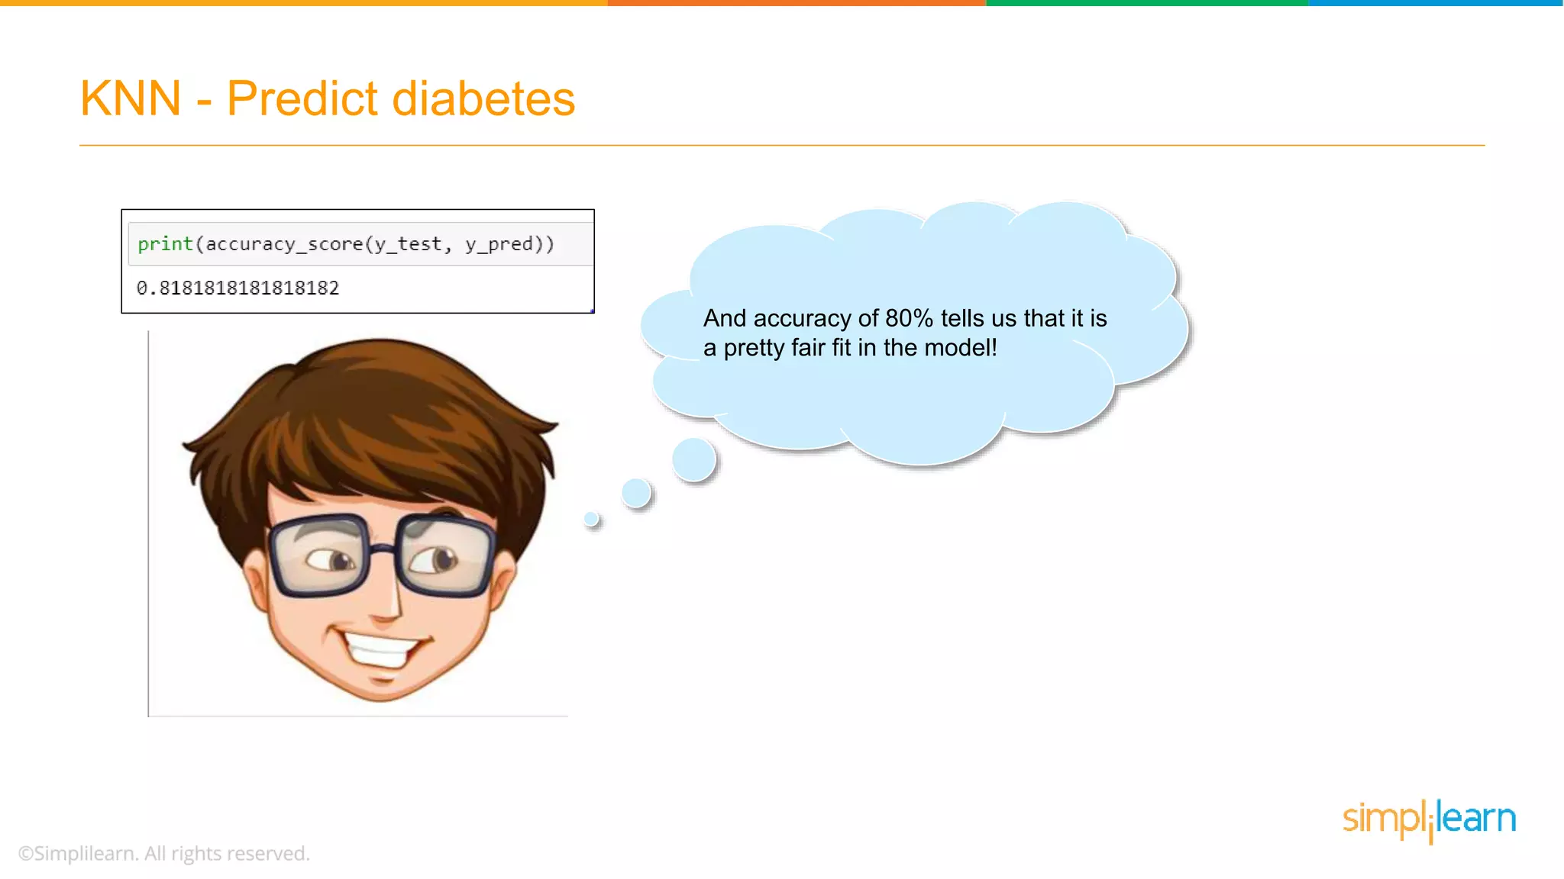
Notes:
Have you asked yourself the question, why do people organize?
Lets go to the psychology of organizing
This predictability applies within the context of our homes, manifesting through the concept of organization

Slide 61
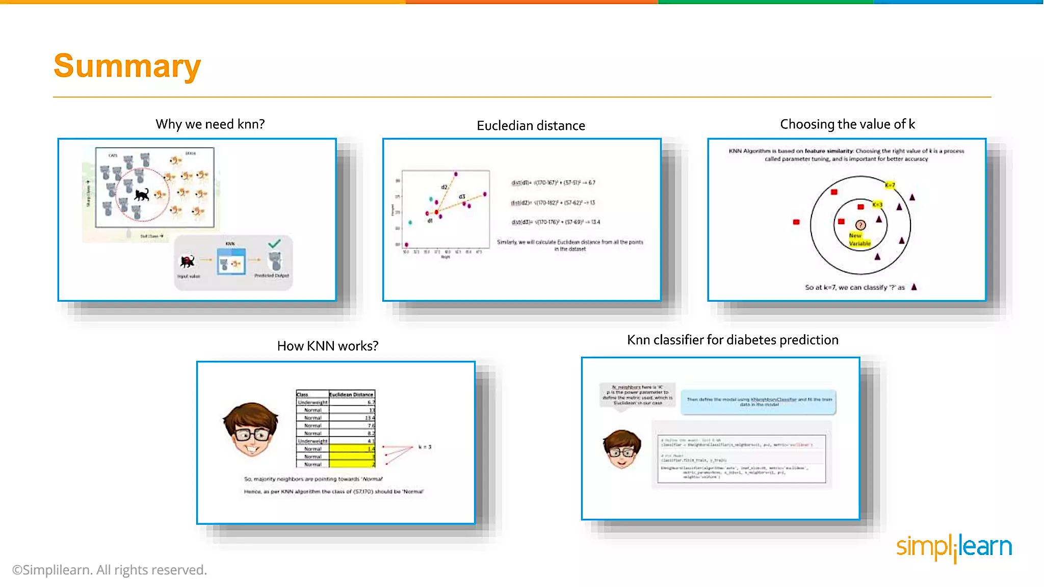
Notes:
Have you asked yourself the question, why do people organize?
Lets go to the psychology of organizing
This predictability applies within the context of our homes, manifesting through the concept of organization

Slide 62
References
https://www.simplilearn.com/tutorials/machine-learning-tutorial/knn-in-python
Notes:
Have you asked yourself the question, why do people organize?
Lets go to the psychology of organizing
This predictability applies within the context of our homes, manifesting through the concept of organization

